Slide 1
Acts 2:37-47
³⁷ Now when they heard this, they were pierced to the heart, and said to Peter and the rest of the apostles, “Brothers, what are we to do?” ³⁸ Peter said to them, “Repent, and each of you be baptized in the name of Jesus Christ for the forgiveness of your sins; and you will receive the gift of the Holy Spirit.

Slide 2
Acts 2:37-47
³⁹ For the promise is for you and your children and for all who are far away, as many as the Lord our God will call to Himself.” ⁴⁰ And with many other words he solemnly testified and kept on urging them, saying, “Be saved from this perverse generation!”

Slide 3
Acts 2:37-47
⁴¹ So then, those who had received his word were baptized; and that day there were added about three thousand souls. ⁴² They were continually devoting themselves to the apostles’ teaching and to fellowship, to the breaking of bread and to prayer.

Slide 4
Acts 2:37-47
⁴³ Everyone kept feeling a sense of awe; and many wonders and signs were taking place through the apostles. ⁴⁴ And all the believers were together and had all things in common; ⁴⁵ and they would sell their property and possessions and share them with all, to the extent that anyone had need.

Slide 5
Acts 2:37-47
⁴⁶ Day by day continuing with one mind in the temple, and breaking bread from house to house, they were taking their meals together with gladness and sincerity of heart, ⁴⁷ praising God and having favor with all the people. And the Lord was adding to their number day by day those who were being saved.

Slide 6

How Can I Have Faith Like Abraham
Deny Self: Work Together as a Team (Part 4)

Slide 7
Matthew 12:22-28
²² Then one was brought to Him who was demon-possessed, blind and mute; and He healed him, so that the blind and mute man both spoke and saw. ²³ And all the multitudes were amazed and said, “Could this be the Son of David?”

Slide 8
Matthew 12:22-28
²⁴ Now when the Pharisees heard it they said, “This fellow does not cast out demons except by Beelzebub, the ruler of the demons.”
²⁵ But Jesus knew their thoughts, and said to them: “Every kingdom divided against itself is brought to desolation, and every city or house divided against itself will not stand.

Slide 9
Matthew 12:22-28
²⁶ If Satan casts out Satan, he is divided against himself. How then will his kingdom stand? ²⁷ And if I cast out demons by Beelzebub, by whom do your sons cast them out? Therefore they shall be your judges. ²⁸ But if I cast out demons by the Spirit of God, surely the kingdom of God has come upon you.

Slide 10

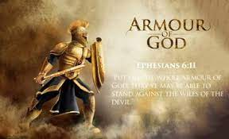

Slide 11
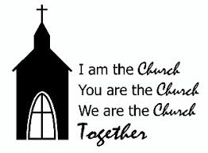
No Room for Confusion

Slide 12
Psalms 133:1
¹ Behold, how good and how pleasant it is
For brothers (God’s People) to dwell together in unity!

Slide 13
2 Corinthians 13:11
¹¹ Finally, brethren, rejoice, be made complete, be comforted, be like-minded, live in peace; and the God of love and peace will be with you.

Slide 14
Military Leadership
Major
Lieutenant Commander
Lieutenant Colonel
Brigadier General

Slide 15
Church Leadership
Elders (Shepherds)
Deacons
Ministers
Evangelists
Teachers

Slide 16
Acts 20:28
²⁸ Be on guard for yourselves and for all the flock, among which the Holy Spirit has made you overseers, to shepherd the church of God which He purchased with His own blood.

Slide 17
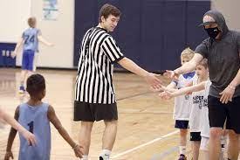
Team Captain

Slide 18
1 Corinthians 12:4-11
⁴ Now there are varieties of gifts, but the same Spirit. ⁵ And there are varieties of ministries, and the same Lord. ⁶ There are varieties of effects, but the same God who works all things in all persons. ⁷ But to each one is given the manifestation of the Spirit for the common good.

Slide 19
1 Corinthians 12:4-11
8 For to one is given the word of wisdom through the Spirit, and to another the word of knowledge according to the same Spirit; 9 to another faith by the same Spirit, and to another gifts of healing by the one Spirit,

Slide 20
1 Corinthians 12:4-11
¹⁰ and to another the effecting of miracles, and to another prophecy, and to another the distinguishing of spirits, to another various kinds of tongues, and to another the interpretation of tongues. ¹¹ But one and the same Spirit works all these things, distributing to each one individually just as He wills.

Slide 21
1 Corinthians 12:14-27
¹⁴ For the body is not one member, but many. ¹⁵ If the foot says, “Because I am not a hand, I am not a part of the body,” it is not for this reason any the less a part of the body. ¹⁶ And if the ear says, “Because I am not an eye, I am not a part of the body,” it is not for this reason any the less a part of the body.

Slide 22
1 Corinthians 12:14-27
¹⁷ If the whole body were an eye, where would the hearing be? If the whole were hearing, where would the sense of smell be? ¹⁸ But now God has placed the members, each one of them, in the body, just as He desired. ¹⁹ If they were all one member, where would the body be?

Slide 23
1 Corinthians 12:14-27
²⁰ But now there are many members, but one body. ²¹ And the eye cannot say to the hand, “I have no need of you”; or again the head to the feet, “I have no need of you.” ²² On the contrary, it is much truer that the members of the body which seem to be weaker are necessary;

Slide 24
1 Corinthians 12:14-27
²³ and those members of the body which we deem less honorable, on these we bestow more abundant honor, and our less presentable members become much more presentable, ²⁴ whereas our more presentable members have no need of it. But God has so composed the body, giving more abundant honor to that member which lacked,

Slide 25
1 Corinthians 12:14-27
²⁵ so that there may be no division in the body, but that the members may have the same care for one another. ²⁶ And if one member suffers, all the members suffer with it; if one member is honored, all the members rejoice with it.
²⁷ Now you are Christ’s body, and individually members of it.

Slide 26
Ephesians 4:1-7
¹ Therefore I, the prisoner of the Lord, implore you to walk in a manner worthy of the calling with which you have been called, ² with all humility and gentleness, with patience, showing tolerance for one another in love, ³ being diligent to preserve the unity of the Spirit in the bond of peace.

Slide 27
Ephesians 4:1-7
⁴ There is one body and one Spirit, just as also you were called in one hope of your calling; ⁵ one Lord, one faith, one baptism, ⁶ one God and Father of all who is over all and through all and in all.
⁷ But to each one of us grace was given according to the measure of Christ’s gift.

Slide 28
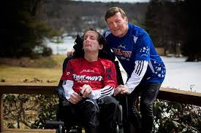
Team Hoyt

Slide 29
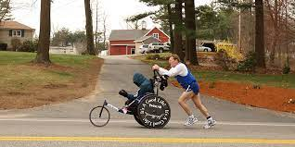
Team Hoyt in Training

Slide 30
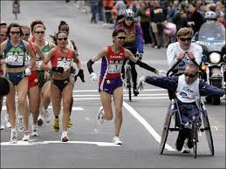
Running a Marathon

Slide 31
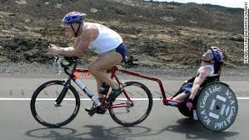
Biking

Slide 32
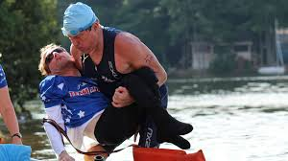
Triathlon

Slide 33
What Teamwork Means to Rick
"Dad, when I’m running, it feels like I’m not handicapped."

Slide 34
1 Thessalonians 5:11
¹¹ Therefore encourage one another and build up one another, just as you also are doing.
Work as a team!

Slide 35
