Slide 1
1 Kings 14:1-20
¹ At that time Abijah the son of Jeroboam became sick. ² And Jeroboam said to his wife, “Now arise and disguise yourself so that they will not know that you are the wife of Jeroboam, and go to Shiloh. Behold, Ahijah the prophet is there, who said regarding me that I would be king over this people.

Slide 2
1 Kings 14:1-20
³ Take ten loaves with you, some pastries, and a jar of honey, and go to him. He will tell you what will happen to the boy.”
⁴ And Jeroboam’s wife did so, and set out and went to Shiloh, and came to the house of Ahijah. Now Ahijah could not see because his eyes were glossy from his old age.

Slide 3
1 Kings 14:1-20
⁵ Now the Lord had said to Ahijah, “Behold, the wife of Jeroboam is coming to inquire of you about her son, because he is sick. You shall say such and such to her, for it will be when she arrives, that she is going to make herself unrecognizable.”

Slide 4
1 Kings 14:1-20
⁶ So when Ahijah heard the sound of her feet coming in the doorway, he said, “Come in, wife of Jeroboam; why do you make yourself unrecognizable? Nevertheless, I am sent to you with a harsh message. ⁷ Go, say to Jeroboam, ‘This is what the Lord, the God of Israel says: “Because I exalted you from among the people and made you leader over My people Israel,

Slide 5
1 Kings 14:1-20
⁸ and tore the kingdom away from the house of David and gave it to you—yet you have not been like My servant David, who kept My commandments and followed Me with all his heart, to do only that which was right in My sight;

Slide 6
1 Kings 14:1-20
⁹ you also have done more evil than all who were before you, and you have gone and made for yourself other gods and cast metal images to provoke Me to anger, and have thrown Me behind your back—

Slide 7
1 Kings 14:1-20
¹⁰ therefore behold, I am bringing disaster on the house of Jeroboam, and I will eliminate from Jeroboam every male person, both bond and free in Israel, and I will make a clean sweep of the house of Jeroboam, just as one sweeps away dung until it is all gone. ¹¹ Anyone belonging to Jeroboam who dies in the city, the dogs will eat. And anyone who dies in the field, the birds of the sky will eat; for the Lord has spoken it.”’

Slide 8
1 Kings 14:1-20
¹² Now you, arise, go to your house. When your feet enter the city the child will die. ¹³ Then all Israel will mourn for him and bury him, for he alone of Jeroboam’s family will come to the grave, because in him something good was found toward the Lord God of Israel in the house of Jeroboam.

Slide 9
1 Kings 14:1-20
¹⁴ Moreover, the Lord will raise up for Himself a king over Israel who will eliminate the house of Jeroboam this day and from now on.

Slide 10
1 Kings 14:1-20
¹⁵ “For the Lord will strike Israel, just as a reed sways in the water; and He will uproot Israel from this good land which He gave to their fathers, and will scatter them beyond the Euphrates River, because they have made their Asherim, provoking the Lord to anger. ¹⁶ He will give up Israel because of the sins of Jeroboam, which he committed and with which he misled Israel into sin.”

Slide 11
1 Kings 14:1-20
¹⁷ Then Jeroboam’s wife arose and departed, and came to Tirzah. As she was entering the threshold of the house, the child died. ¹⁸ Then all Israel buried him and mourned for him, in accordance with the word of the Lord which He had spoken through His servant Ahijah the prophet.

Slide 12
1 Kings 14:1-20
¹⁹ Now as for the rest of the acts of Jeroboam, how he made war and how he reigned, behold, they are written in the Book of the Chronicles of the Kings of Israel. ²⁰ And the time that Jeroboam reigned was twenty-two years; and he lay down with his fathers, and his son Nadab reigned in his place.

Slide 13

Do we make God our Backup Plan
Sins of Jeroboam 1 Kings 14

Slide 14
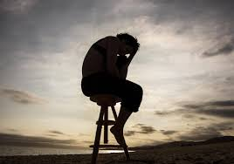
Despair

Slide 15


Slide 16





Hypocrisy

Slide 17
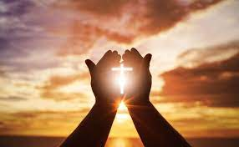
What Prayer Should Be!

Slide 18

Last Resort?

Slide 19
Great Leaders Follow God!
Hebrews 13:7
⁷ Remember those who led you, who spoke the word of God to you; and considering the result of their conduct, imitate their faith.

Slide 20
Numbers 32:23
²³ But if ye will not do so, behold, ye have sinned against the Lord: and be sure your sin will find you out.

Slide 21
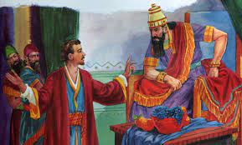
Soothsayers and Magicians

Slide 22
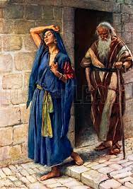
Disguise

Slide 23
1 Kings 14:6
⁶ When Ahijah heard the sound of her feet coming in the doorway, he said, “Come in, wife of Jeroboam, why do you pretend to be another woman? For I am sent to you with a harsh message.

Slide 24
Psalms 139:1-2
¹ O Lord, You have searched me and known me.
² You know when I sit down and when I rise up;
You understand my thought from afar.

Slide 25
Hebrews 4:13
¹³ And there is no creature hidden from His sight, but all things are open and laid bare to the eyes of Him with whom we have to do.

Slide 26
Hebrews 10:25
²⁵ not forsaking our own assembling together, as is the habit of some, but encouraging one another; and all the more as you see the day drawing near.

Slide 27
1 Kings 14:12
¹² Now you, arise, go to your house. When your feet enter the city the child will die.

Slide 28
1 Kings 14:9
⁹ you also have done more evil than all who were before you, and have gone and made for yourself other gods and molten images to provoke Me to anger, and have cast Me behind your back-

Slide 29
1 Kings 14:13
¹³ All Israel shall mourn for him and bury him, for he alone of Jeroboam’s family will come to the grave, because in him something good was found toward the Lord God of Israel in the house of Jeroboam.

Slide 30
1 Kings 14:14
¹⁴ Moreover, the Lord will raise up for Himself a king over Israel who will cut off the house of Jeroboam this day and from now on.

Slide 31
What can we take from this lesson:
We cannot hide from God! There is a consequence for sin!
God is our God in good times and bad.
His response relies on the relationship we have with him.
He will not be our back up plan. 1 Thessalonians 5:17 “Pray without ceasing!”

Slide 32
