Slide 1
1 Samuel 4:12-18
¹² Now a man of Benjamin ran from the battle line and came to Shiloh the same day with his clothes torn, and dust on his head. ¹³ When he came, behold, Eli was sitting on his seat by the road keeping watch, because his heart was anxious about the ark of God. And the man came to give a report in the city, and all the city cried out.

Slide 2
1 Samuel 4:12-18
¹⁴ When Eli heard the noise of the outcry, he said, “What does the noise of this commotion mean?” Then the man came hurriedly and told Eli. ¹⁵ Now Eli was ninety-eight years old, and his eyes were fixed and he could not see.

Slide 3
1 Samuel 4:12-18
¹⁶ The man said to Eli, “I am the one who came from the battle line. Indeed, I escaped from the battle line today.” And he said, “How are things, my son?” ¹⁷ Then the one who brought the news replied, “Israel has fled before the Philistines and there has also been a great defeat among the people, and your two sons, Hophni and Phinehas are also dead; and the ark of God has been taken.”

Slide 4
1 Samuel 4:12-18
¹⁸ When he mentioned the ark of God, Eli fell off the seat backward beside the gate, and his neck was broken and he died, for he was old and heavy. And so he judged Israel for forty years.

Slide 5
God’s Expectation and Judgment
Eli’s Household

Slide 6
1 Samuel 4:5
⁵ As the ark of the covenant of the Lord came into the camp, all Israel shouted with a great shout, so that the earth resounded.

Slide 7
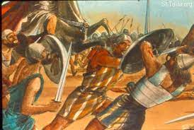
Hophni and Phinehas Die by the Sword!

Slide 8
1 Samuel 2:22-25
²² Now Eli was very old; and he heard all that his sons were doing to all Israel, and how they lay with the women who served at the doorway of the tent of meeting. ²³ He said to them, “Why do you do such things, the evil things that I hear from all these people?

Slide 9
1 Samuel 2:22-25
24 No, my sons; for the report is not good which I hear the Lord’s people circulating. 25 If one man sins against another, God will mediate for him; but if a man sins against the Lord, who can intercede for him?” But they would not listen to the voice of their father, for the Lord desired to put them to death.

Slide 10
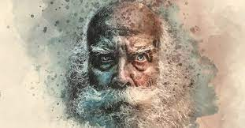
Portrait of an Old Man

Slide 11
Proverbs 13:24
²⁴ He who withholds his rod hates his son,
But he who loves him disciplines him diligently.

Slide 12
“Spare the Rod, Spoil the Child!”

Slide 13
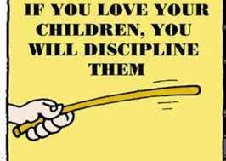
“The Rod!”

Slide 14
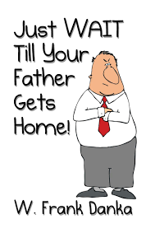
Mom’s Effective Method of Discipline

Slide 15
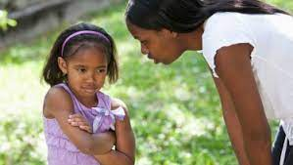
“No!”

Slide 16
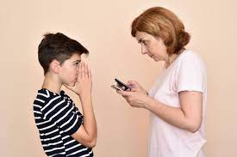

Slide 17
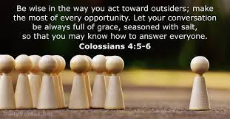

Slide 18
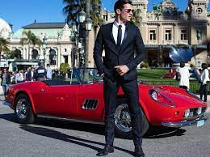
Misplaced Wealth

Slide 19
1 Samuel 3:13-14
¹³ “For I have told him that I am about to judge his house forever for the iniquity which he knew, because his sons brought a curse on themselves and he did not rebuke them. ¹⁴ Therefore I have sworn to the house of Eli that the iniquity of Eli’s house shall not be atoned for by sacrifice or offering forever.”

Slide 20
Ezekiel 3:18-20
¹⁸ When I say to the wicked, ‘You will surely die,’ and you do not warn him or speak out to warn the wicked from his wicked way that he may live, that wicked man shall die in his iniquity, but his blood I will require at your hand. ¹⁹ Yet if you have warned the wicked and he does not turn from his wickedness or from his wicked way, he shall die in his iniquity; but you have delivered yourself.

Slide 21
Ezekiel 3:18-20
²⁰ Again, when a righteous man turns away from his righteousness and commits iniquity, and I place an obstacle before him, he will die; since you have not warned him, he shall die in his sin, and his righteous deeds which he has done shall not be remembered; but his blood I will require at your hand.

Slide 22
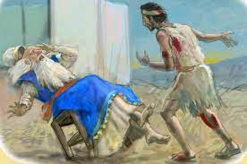
Eli’s Death

Slide 23
2 Thessalonians 3:14-15
¹⁴ If anyone does not obey what we say in this letter, take note of that person, and have nothing to do with him, that he may be ashamed. ¹⁵ Do not regard him as an enemy, but warn him as a brother.

Slide 24
Questions to Consider!
What do we do with what we know? When we see wrong do we act?
Do we call out sin or simply tolerate it?
Do we understand we’ll be held accountable for our inaction?

Slide 25
Questions to Consider!
Do we have the right relationship with those closest to us to rescue them from sin? Father, mother, child, friend, co-worker, classmate, Brother or Sister in Christ?
Do we recognize God’s expectations and his ultimate judgment?

Slide 26
