Slide 1
Ephesians 6:1-4
6 Children, obey your parents in the Lord, for this is right. ² Honor your father and mother (which is the first commandment with a promise), ³ so that it may turn out well for you, and that you may live long on the earth.
⁴ Fathers, do not provoke your children to anger, but bring them up in the discipline and instruction of the Lord.

Slide 2
Psalm 127:3-5
³ Behold, children are a gift of the Lord,
The fruit of the womb is a reward.
⁴ Like arrows in the hand of a warrior,
So are the children of one’s youth.
⁵ Blessed is the man whose quiver is full of them;
They will not be ashamed
When they speak with their enemies in the gate.

Slide 3
Examples of Godly Women

Slide 4
Doris Ann Bartanen
January 4, 1936 - July 1, 2022

Slide 5
Living the Simple Life
The happiest people don’t have the best of everything, they just make the best of what they have.
UNKNOWN

Slide 6
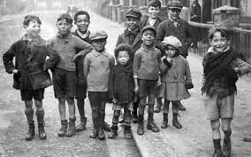
1929-1939

Slide 7
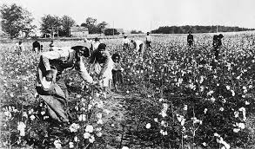
Picking Cotton near Henderson, Tennessee

Slide 8
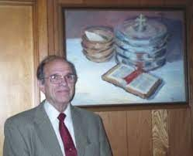
Marry a Preacher

Slide 9
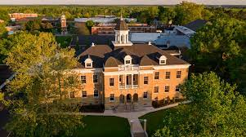
Freed-Hardeman University

Slide 10
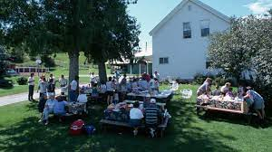
Family Gatherings

Slide 11
1 Samuel
but the Lord had closed her womb.

Slide 12
1 Samuel 1:22
22 But Hannah did not go up, for she said to her husband, “I will not go until the child is weaned; then I will bring him, so that he may appear before the Lord and stay there for life.”

Slide 13
3 Points of Discussion
*Hannah honors her commitment to the Lord
*What is meant by “Weaning”
*Samuel would stay in the Place of Worship, Forever!

Slide 14
Genesis 21:8
8 And the child grew and was weaned, and Abraham held a great feast on the day that Isaac was weaned.

Slide 15
Weaning a Child
Between the ages of 2 and 4
The child is very young!

Slide 16
1 Samuel 1:24
24 Now when she had weaned him, she took him up with her, with a three-year-old bull, one ephah of flour, and a jug of wine, and brought him to the house of the Lord in Shiloh, although the child was young.

Slide 17
1 Samuel 2:18-19
18 Now Samuel was ministering before the Lord, as a boy wearing a linen ephod. 19 And his mother would make for him a little robe and bring it up to him from year to year when she would come up with her husband to offer the yearly sacrifice.

Slide 18
Boyhood!
How old is someone who is considered a Boy!

Slide 19
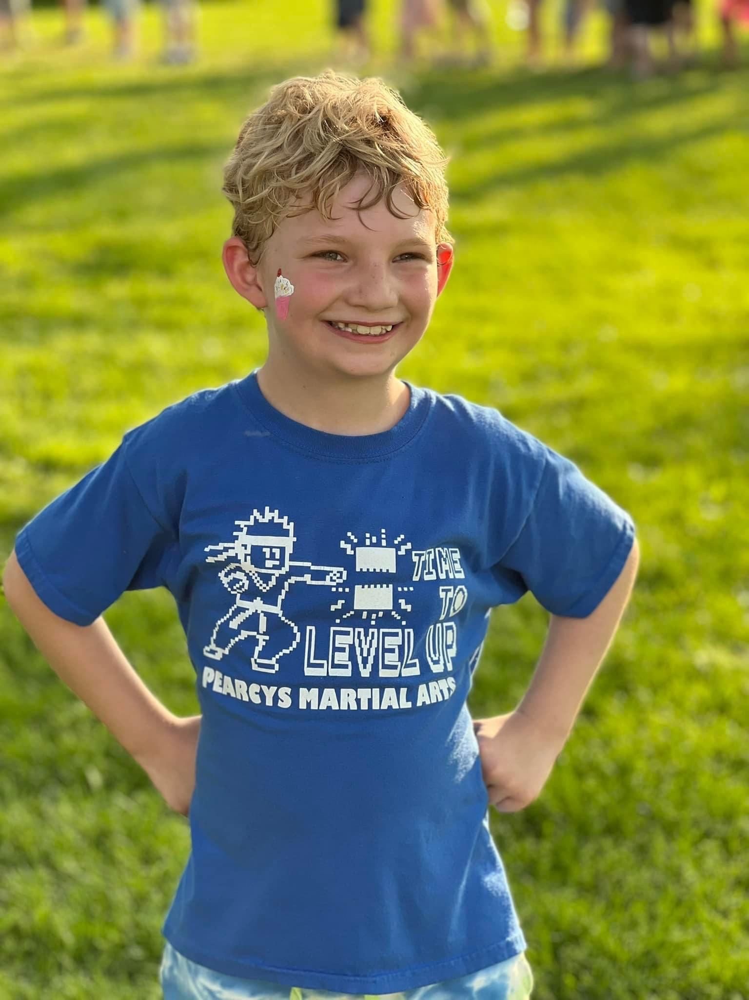
Silas

Slide 20
Final Thoughts
We have examples of Godly parents all around us today who know how to build spiritual relationships with their children.
We need to open our hearts and minds to these examples so that those relationships will be perpetuated.

Slide 21
Final Thoughts
Serving God takes personal sacrifice. Hannah made a great sacrifice by dedicating her son to the Lord. A child she pleaded with God to have.

Slide 22
Parallel Point
We haven’t mentioned this, but hopefully we see the parallel from Hannah’s story and the sacrifice God has made through his only begotten Son!

Slide 23
