Slide 1

Studies
In
Christianity

Slide 2
Barriers Before the Gates #5
A Self-righteous Attitude

Slide 3

Sin separates all people from God.
Romans 3: 10
There is none righteous, not even one.
Romans 3: 23
There is no distinction; 23 for all have sinned and fall short of the glory of God,

Slide 4
Micah 3: 4
Then they will cry out to the Lord, but He will not answer them. Instead, He will hide His face from them at that time because they have practiced evil deeds.

Slide 5
Isaiah 59: 1-2
Behold, the Lord's hand is not so short That it cannot save; Nor is His ear so dull that it cannot hear. 2 But your iniquities have made a separation between you and your God, And your sins have hidden His face from you so that He does not hear.

Slide 6
Separation from God is called death.
Romans 6: 23
For the wages of sin is death, but the free gift of God is eternal life in Christ Jesus our Lord.

Slide 7
Isaiah 53: 6
All of us like sheep have gone astray, each of us has turned to his own way; but the Lord has caused the iniquity of us all to fall on Him.

Slide 8
I Timothy 1: 15
It is a trustworthy statement, deserving full acceptance, that Christ Jesus came into the world to save sinners, among whom I am foremost of all.
Mark 10: 45
For even the Son of Man did not come to be served, but to serve, and to give His life a ransom for many.

Slide 9
II Corinthians 5: 18
Now all these things are from God, who reconciled us to Himself through Christ and gave us the ministry of reconciliation, 19 namely, that God was in Christ reconciling the world to Himself, not counting their trespasses against them, and He has committed to us the word of reconciliation. 20 Therefore, we are ambassadors for Christ, as though God were making an appeal through us; we beg you on behalf of Christ, be reconciled to God. 21 He made Him who knew no sin to be sin on our behalf, so that we might become the righteousness of God in Him.

Slide 10
Titus 3: 5
He saved us, not on the basis of deeds which we have done in righteousness, but according to His mercy, by the washing of regeneration and renewing by the Holy Spirit, 6 whom He poured out upon us richly through Jesus Christ our Savior, 7 so that being justified by His grace we would be made heirs according to the hope of eternal life.

Slide 11
Ephesians 2: 8-10
For by grace you have been saved through faith; and not of yourselves, it is the gift of God; 9 not as a result of works, so that no one may boast. 10 For we are His workmanship, created in Christ Jesus for good works, which God prepared beforehand so that we would walk in them.

Slide 12
Romans 3: 10
There is none righteous, not even one.
Romans 3: 23
There is no distinction; 23 for all have sinned and fall short of the glory of God,
Matthew 5: 48
Therefore you are to be perfect, as your heavenly Father is perfect

Slide 13
Acts 3: 19
Therefore repent and return, so that your sins may be wiped away, in order that times of refreshing may come from the presence of the Lord;
I John 1: 10
If we confess our sins, He is faithful and righteous to forgive us our sins and to cleanse us from all unrighteousness. 10 If we say that we have not sinned, we make Him a liar and His word is not in us.

Slide 14

I. Unbelievers complain that
Christians have a “Holier
than thou” attitude.
secret sins.

Slide 15
Luke 15: 1
Now all the tax collectors and the sinners were coming near Him to listen to Him. 2 Both the Pharisees and the scribes began to grumble, saying, "This man receives sinners and eats with them." 3 So He told them this parable, saying, 4 "What man among you, if he has a hundred sheep and has lost one of them, does not leave the ninety-nine in the open pasture and go after the one which is lost until he finds it?

Slide 16
I Corinthians 9: 20
To the Jews I became as a Jew, so that I might win Jews; to those who are under the Law, as under the Law …. 21 to those who are without law, as without law, …. 22 To the weak I became weak, that I might win the weak; I have become all things to all men, so that I may by all means save some.

Slide 17
Hebrew 4: 15
For we do not have a high priest who cannot sympathize with our weaknesses, but One who has been tempted in all things as we are, yet without sin.

Slide 18
Having a “Holier than thou” attitude makes evangelism difficult.

Slide 19
No one likes to be look down upon.
We are all sinners, even Christians.
How are Christians morally superior?
II Corinthians 5: 21
He made Him who knew no sin to be sin on our behalf, so that we might become the righteousness of God in Him.

Slide 20
II Corinthians 5: 18
Now all these things are from God, who reconciled us to Himself through Christ and gave us the ministry of reconciliation, 19 namely, that God was in Christ reconciling the world to Himself, not counting their trespasses against them, and He has committed to us the word of reconciliation. 20 Therefore, we are ambassadors for Christ, as though God were making an appeal through us; we beg you on behalf of Christ, be reconciled to God.

Slide 21
This self-righteous attitude
discourages spiritual growth.

Slide 22
It discourages others in the
congregation from seeking
spiritual growth.

Slide 23
Those who feel self-satisfied are not motivated to grow / develop spiritually.

Slide 24
Our spiritual growth facilitates our ministry,
our ambassadorship, the work for which we were created in Christ Jesus.

Slide 25
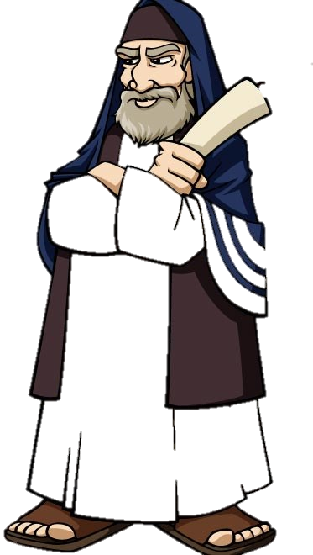
The Pharisees kept
the Law more perfectly
than any other group.

Slide 26
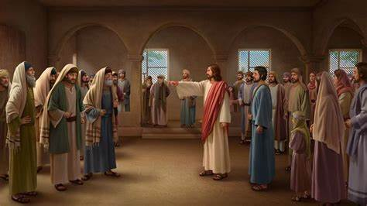
Jesus rebuked the Pharisees

Slide 27
Luke 11: 39
But the Lord said to him, "Now you Pharisees clean the outside of the cup and of the platter; but inside of you, you are full of robbery and wickedness.

Slide 28
Love for the unsaved shines so brightly it cannot be hidden.

