Slide 1

Studies
In
Christianity

Slide 2
Barriers Before the Gates #2
Failure to Confess One’s Sins

Slide 3

David is a hero in the faith.
Acts 13: 22
After He had removed him, He raised up David to be their king, concerning whom He also testified and said, 'I have found David the son of Jesse, a man after My heart, who will do all My will.'

Slide 4

God measured others by David.
I Kings 14: 8
Because I exalted you … , 8 and tore the kingdom away from the house of David and gave it to you — yet you have not been like My servant David, who kept My commandments and who followed Me with all his heart, to do only that which was right in My sight;

Slide 5

Though David was a man after God’s heart and devoted to God, he sinned grievously.

Slide 6
God doesn’t want an adversarial relationship with man.
I Timothy 2: 3
This is good and acceptable in the sight of God our Savior, 4 who desires all men to be saved and to come to the knowledge of the truth.

Slide 7


The goal of this lesson is to discuss the confession of sin, not confession of faith.

Slide 8

I. There is great comfort
that comes from openly
dealing with one’s sins.

Slide 9
Psalm 32: 1
How blessed is he whose transgression is forgiven, Whose sin is covered! 2 How blessed is the man to whom the Lord does not impute iniquity, And in whose spirit there is no deceit!

Slide 10
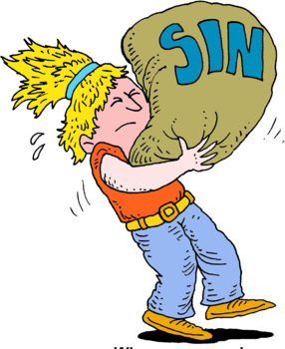
Sin is a heavy burden to carry.
Proverbs 28:13
He who conceals his transgressions will not prosper, but he who confesses and forsakes them will find compassion.

Slide 11
David describes his failures in four ways :
      Transgression, Sins
Iniquity, Deceit.

Slide 12
“Transgression”
is the rebellion against God’s rule.
Hebrews 10: 26
For if we go on sinning willfully after receiving the knowledge of the truth, there no longer remains a sacrifice for sins,

Slide 13

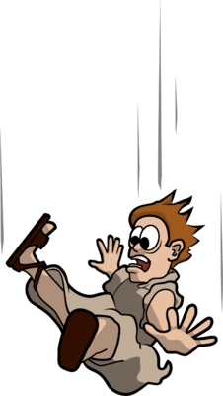
“Sin” falling short of the standard.
Romans 3: 23
for all have sinned and fall short of the glory of God,
Matthew 5: 48
Therefore you are to be perfect, as your heavenly Father is perfect.

Slide 14
God didn’t deal with David as a sinner.
Psalms 103: 12
As far as the east is from the west, so far hath He removed our transgressions from us.

Slide 15
Isaiah 1: 18
“Come now, and let us reason together,” Says the Lord, “Though your sins are as scarlet, They will be as white as snow; Though they are red like crimson, They will be like wool. “

Slide 16
Matthew 18: 22
Jesus said to him, “I do not say to you, up to seven times, but up to seventy times seven.”
Once forgiven, it never happened.

Slide 17

II. When a Christian doesn’t
deal with his sins, he
needlessly bears a great
burden of guilt.

Slide 18
Psalms 32: 3 ­
When I kept silent about my sin, my body wasted away through my groaning all day long. 4 For day and night Your hand was heavy upon me; My vitality was drained away as with the fever heat of summer.

Slide 19
Titus 1: 15
To the pure, all things are pure; but to those who are defiled and unbelieving, nothing is pure, but both their mind and their conscience are defiled.

Slide 20

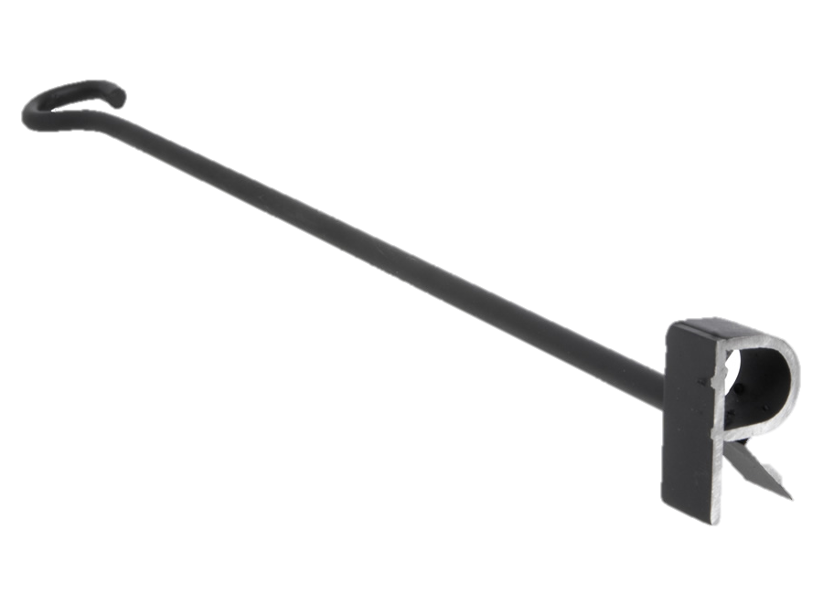
I Timothy 4: 2
by means of the hypocrisy of liars seared in their own conscience as with a branding iron
( cauterized to destroy sensitivity )

Slide 21
The Apostle Paul dealt with regret
he did not deal with guilt.
I Timothy 1: 15
It is a trustworthy statement, deserving full acceptance, that Christ Jesus came into the world to save sinners, among whom I am foremost.

Slide 22
Philippians 3: 13-14
Brethren, I do not regard myself as having laid hold of it yet; but one thing I do: forgetting what lies behind and reaching forward to what lies ahead, 14 I press on toward the goal for the prize of the upward call of God in Christ Jesus.

Slide 23
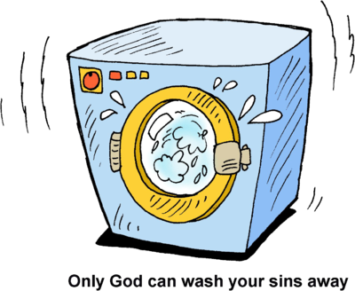
Acts 22: 16
Now why do you delay? Get up and be baptized, and wash away your sins, calling on His name.’

Slide 24
I Peter 3: 21
Corresponding to that, baptism now saves you — not the removal of dirt from the flesh, but an appeal to God for a good conscience — through the resurrection of Jesus Christ,

Slide 25
Hebrews 9: 14
How much more will the blood of Christ, who through the eternal Spirit offered Himself without blemish to God, cleanse your conscience from dead works to serve the living God?

Slide 26
III. It is hard to comprehend a
God who is so willing to
forgive sinners, those who
reject His rule in their lives.

Slide 27
Psalms 32: 5
I acknowledged my sin to You, And my iniquity I did not hide; I said, “I will confess my transgressions to the Lord”; And You forgave the guilt of my sin.

Slide 28
I John 1: 8
If we say that we have no sin, we are deceiving ourselves and the truth is not in us. 9 If we confess our sins, He is faithful and righteous to forgive us our sins and to cleanse us from all unrighteousness.

Slide 29
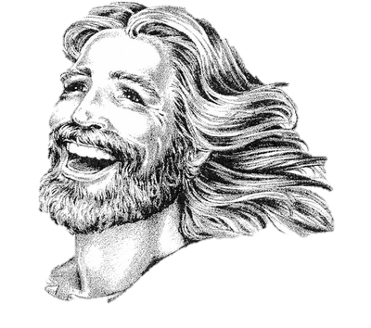
Micah 7: 18
Who is a God like You, who pardons iniquity and passes over the rebellious act of the remnant of His possession? He does not retain His anger forever; Because He delights in unchanging love.

Slide 30
No Christian should ever bear
the burden of guilt.
I Peter 5: 6
Therefore ﻿﻿humble yourselves under the mighty hand of God, that He may exalt you at the proper time, 7 casting all your anxiety on Him, because He cares for you.

Slide 31
God requires we discuss our sins with each other.
James 5: 16
Therefore, confess your sins to one another, and pray for one another so that you may be healed. The effective prayer of a righteous man can accomplish much.

Slide 32
If you were to die this very moment, do you know for
for certain you would go to
be with God eternally.

