Slide 1

Studies
In
Christianity

Slide 2
Barriers Before the Gates #1
Overcoming An Unforgiving Heart

Slide 3


Salvation is a free gift
and available to all :
Romans 6: 23
For the wages of sin is death, but the free gift of God is eternal life in Christ Jesus our Lord.

Slide 4
Romans 10: 17
So faith comes from hearing, and hearing by the word of Christ.
Hebrews 11: 6
And without faith it is impossible to please Him, for he who comes to God must believe that He is and that He is a rewarder of those who seek Him.

Slide 5
Ephesians 2: 8
For by grace you have been saved through faith; and that not of yourselves, it is the gift of God; 9 not as a result of works, so that no one may boast.

Slide 6
II Thessalonians 1:8
… when the Lord Jesus will be revealed from heaven with His mighty angels in flaming fire, 8 dealing out retribution to those who do not know God and to those who do not obey the gospel of our Lord Jesus.

Slide 7
I Corinthians 15: 1
Now I make known to you, brethren, the gospel which I preached to you, which also you received, in which also you stand, 2 by which also you are saved, if you hold fast the word which I preached to you, unless you believed in vain. 3 For I delivered to you as of first importance what I also received, that Christ died for our sins according to the Scriptures, 4 and that He was buried, and that He was raised on the third day according to the Scriptures,

Slide 8
Acts 22: 16
Now why do you delay? Get up and be baptized, and wash away your sins, calling on His name.'
Mark 16: 15 – He said to them, Go into all the world and preach the gospel to all creation. 16 He who has believed and has been baptized shall be saved; but he who has disbelieved shall be condemned.

Slide 9

I. You and everyone you
have ever known need
forgiveness.

Slide 10
Romans 3: 10
As it is written, There is none righteous, not even one; 23 for there is no distinction; 23 for all have sinned and fall short of the glory of God
I John 1: 10
If we say that we have not sinned, we make Him a liar and His word is not in us.

Slide 11
More than we think,
we all sin in many ways.
I John 3: 4
Everyone who practices sin also practices lawlessness; and sin is lawlessness.

Slide 12
Romans 13: 1
Every person is to be in subjection to the governing authorities. For there is no authority except from God, and those which exist are established by God. 2 Therefore whoever resists authority has opposed the ordinance of God; and they who have opposed will receive condemnation upon themselves.

Slide 13
Romans 14: 22
The faith which you have, have as your own conviction before God. Happy is he who does not condemn himself in what he approves. 23 But he who doubts is condemned if he eats, because his eating is not from faith; and whatever is not from faith is sin.

Slide 14
Matthew 5: 27
You have heard that it was said, 'You shall not commit adultery'; 28 but I say to you that everyone who looks at a woman with lust for her has already committed adultery with her in his heart.

Slide 15

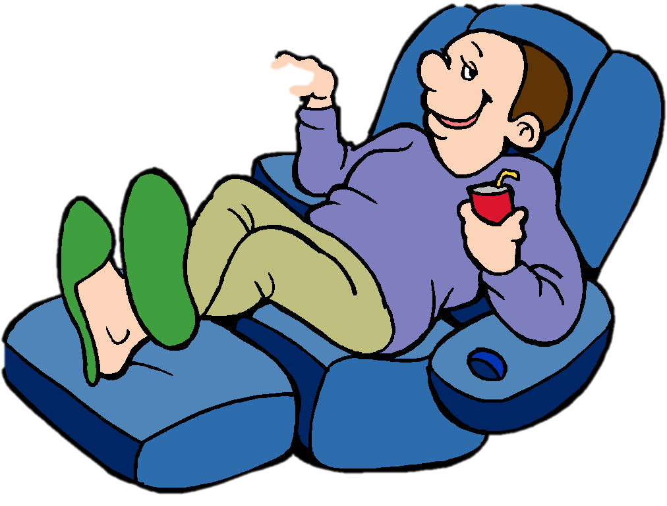
James 4: 17
Therefore, to one who knows the right thing to do and does not do it, to him it is sin.

Slide 16
II. Christians are commanded
to forgive other people, so
not to do so is sinful.

Slide 17
Colossians 3: 12
So, as those who have been chosen of God, holy and beloved, put on a heart of compassion, kindness, humility, gentleness and patience; 13 bearing with one another, and forgiving each other, whoever has a complaint against anyone; just as the Lord forgave you, so also should you.

Slide 18
Ephesians 4: 31
Let all bitterness and wrath and anger and clamor and slander be put away from you, along with all malice. 32 Be kind to one another, tender-hearted, forgiving each other, just as God in Christ also has forgiven you.
Matthew 22: 39
The second is like it, 'You shall love your neighbor as yourself.'

Slide 19
James 2: 13
For judgment will be merciless to one who has shown no mercy; mercy triumphs over judgment.
Galatians 6: 7
Do not be deceived, God is not mocked; for whatever a man sows, this he will also reap.

Slide 20
Luke 17: 3
Pay attention to yourselves! If your brother sins, rebuke him, and if he repents, forgive him, 4 and if he sins against you seven times in the day, and turns to you seven times, saying, 'I repent,' you must forgive him." 5 The apostles said to the Lord, “Increase our faith!”
(ESV)

Slide 21
Matthew 18: 22
Jesus said to him, “I do not say to you, up to seven times, but up to seventy times seven.”
Luke 17: 3
If your brother sins, rebuke him,

Slide 22
III. One cannot receive what
he is unwilling to give.

Slide 23
Mark 11: 25
Whenever you stand praying, forgive, if you have anything against anyone, so that your Father who is in heaven will also forgive you your transgressions.
Matthew 6: 12
And forgive us our debts, as we also have forgiven our debtors.

Slide 24
Jesus clearly states the lesson of both parables.
Luke 7:47
For this reason I say to you, her sins, which are many, have been forgiven, for she loved much; but he who is forgiven little, loves little.

Slide 25
Matthew 18: 24
And his lord, moved with anger, handed him over to the torturers until he should repay all that was owed him. 35 My heavenly Father will also do the same to you, if each of you does not forgive his brother from your heart."

Slide 26
IV. Forgiveness is given,
not earned.

Slide 27

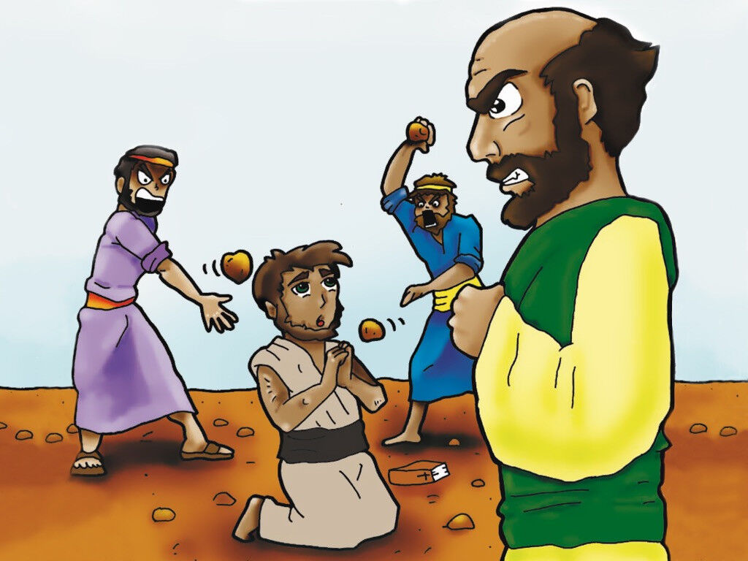
Acts 7: 60
Luke 23:24

Slide 28
True forgiveness comes
from a heart of love.
Matthew 18: 35
My heavenly Father will also do the same to you, if each of you does not forgive his brother from your heart.

Slide 29
We do not deserve forgiveness
God gives it as a gift of grace.
Ephesians 2: 8
For by grace you have been saved through faith; and that not of yourselves, it is the gift of God;

Slide 30
Romans 4: 7
Blessed are those whose lawless deeds have been forgiven, and whose sins have been covered. 8 “Blessed is the man whose sin the Lord will not take into account.”

Slide 31

Does your heart forgive
by nature?
Or is it creating a barrier before the gates?

Slide 32

Thank
You !

