Slide 1

Studies
In
Christianity

Slide 2
Private Worship #5
Walking Daily With God

Slide 3

Next lessons will topics that
lend themselves well to be
used in personal worship.

Slide 4

Hebrews 11: 6
And without faith it is impossible to please Him, for he who comes to God must believe that He is and that He is a rewarder of those who seek Him.

Slide 5

The existence of God :
Reasons some don’t believe
Different views of God
Reasons to believe in God
What the bible says about God

Slide 6

I. Five (5) reasons why some
don’t believe in God.

Slide 7


Psa. 14: 1 & 53: 1
The fool has said in his heart, "There is no God."

Slide 8
The atheists must consider
what is the alternative
to God ?
Nothing !

Slide 9
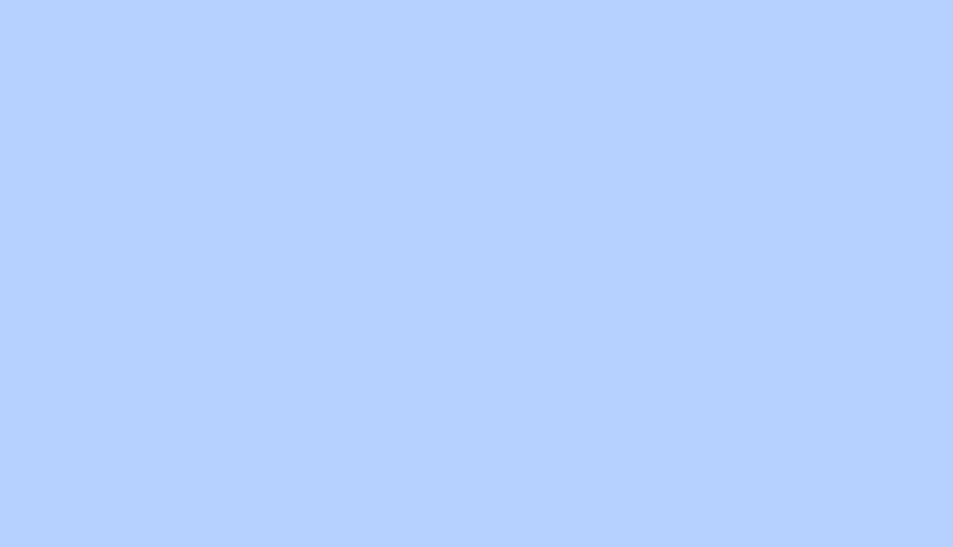
“We are evolved products of natural selection which operates without intension, foresight or purpose …… On a scientific understanding of ourselves there is no evidence for immaterial souls, spirits, mental essence or disembodied selves which stand apart from the physical world.”
www.naturalism.org

Slide 10

There are at least
five (5) reasons why
some people don’t
believe in God.

Slide 11

1. They don’t believe the bible.

Slide 12

Genesis 1: 1
In the beginning God created
the heavens and the earth.
II Timothy 3: 16
All Scripture is inspired by God and profitable for teaching, for reproof, for correction, for training in righteousness; 17 so that the man of God may be adequate, equipped for every good work.

Slide 13

John 5: 39
You search the Scriptures because you think that in them you have eternal life; it is these that testify about Me; 40 and you are unwilling to come to Me so that you may have life.
Romans 10: 17
So faith comes from hearing, and
hearing by the word of Christ.

Slide 14

2. They suppress the truth.
( They purge it from their minds. )

Slide 15
Romans 1: 18
For the wrath of God is revealed from heaven against all ungodliness and unrighteousness of men who suppress the truth in unrighteousness, 19 because that which is known about God is evident within them; for God made it evident to them. 20 For since the creation of the world His invisible attributes, His eternal power and divine nature, have been clearly seen, being understood through what has been made, so that they are without excuse.

Slide 16

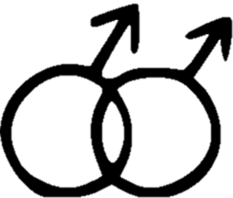
Romans 1: 24
Therefore God gave them over in the lusts of their hearts to impurity, so that their bodies would be dishonored among them. 25 For they exchanged the truth of God for a lie, and worshiped and served the creature rather than the Creator, who is blessed forever.

Slide 17

3. They fear accountability.

Slide 18
Romans 1: 28
And just as they did not see fit to acknowledge God any longer, God gave them over to a depraved mind, to do those things which are not proper, 29 being filled with all unrighteousness, ….. 32 and although they know the ordinance of God, that those who practice such things are worthy of death, they not only do the same, but also give hearty approval to those who practice them.

Slide 19
Romans 2: 12
For all who have sinned without the Law will also perish without the Law, and all who have sinned under the Law will be judged by the Law;

Slide 20

4. They like their lifestyle and
don’t want to change.

Slide 21

5. They reject God because
cannot explain Him.

Slide 22
II. There are at least seven (7)
different views of God.

Slide 23
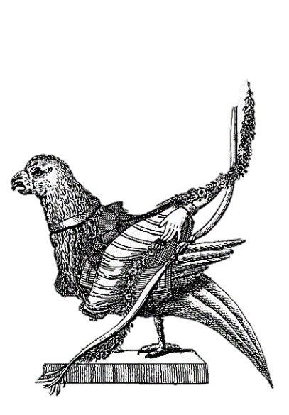
Atheist Deist
Agnostic Animist
Pantheist Monotheist
Polytheistic

Slide 24
III. Four ( 4 ) evidences for
the existence of God.

Slide 25

1. Intelligent design
( teleological )
Romans 1: 20
For since the creation of the world His invisible attributes, His eternal power and divine nature, have been clearly seen, being understood through what has been made, so that they are without excuse.

Slide 26
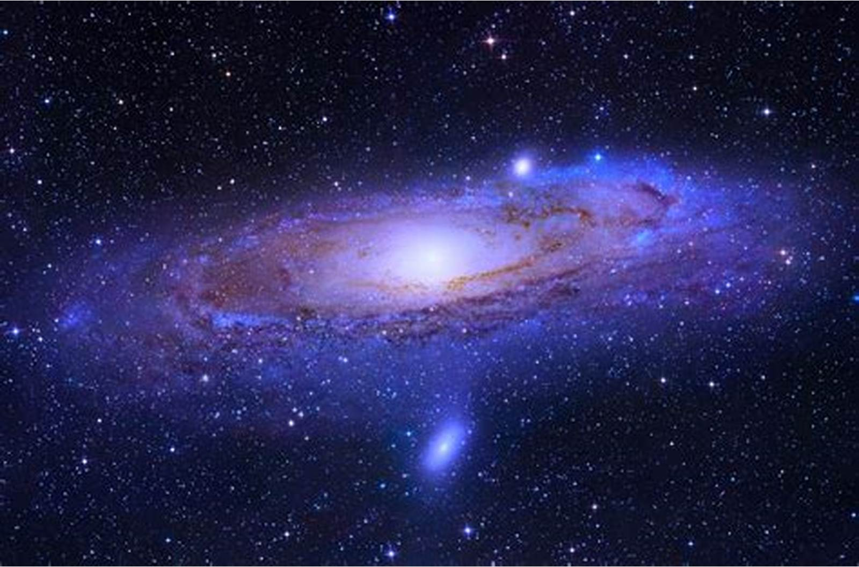
Psalms 19: 1
The heavens are telling of the glory of God; and their expanse is declaring the work of His hands

Slide 27

2. Personality

Slide 28
Genesis 2: 27
God created man in His own image, in the image of God He created him; male and female He created them.
Acts 17: 29
Being then the children of God, we ought not to think that the Divine Nature is like gold or silver or stone, ….

Slide 29
3. Conscience & Morality
Romans 2: 14
For when Gentiles who do not have the Law do instinctively the things of the Law, these, not having the Law, are a law to themselves, 15 in that they show the work of the Law written in their hearts, their conscience bearing witness and their thoughts alternately accusing or else defending them, 16 on the day when, according to my gospel, God will judge the secrets of men through Christ Jesus.

Slide 30
4. Worship
Archeologist and Anthropologist have never discovered a culture that did not worship.
In the 4th century Augustine wrote :
“You have made us for yourself, O Lord, and
our heart is restless until it rests in you.”

Slide 31
IV. What does the bible say
about the existence of God.

Slide 32
Genesis 1: 1
In the beginning God created the heavens and the earth.
Hebrews 11: 6
And without faith it is impossible to please Him, for he who comes to God must believe that He is and that He is a rewarder of those who seek Him.

Slide 33
Exodus 3: 13
Then Moses said to God, "Behold, I am going to the sons of Israel, and I will say to them, 'The God of your fathers has sent me to you.' Now they may say to me, 'What is His name?' What shall I say to them?" 14 God said to Moses, " I AM WHO I AM"; and He said, "Thus you shall say to the sons of Israel, ' I AM has sent me to you.'"

Slide 34
“I AM” Related to the name of God, YHWH, rendered Lord, which is derived from the verb HAYAH, to be. Thus, the God who is in a perpetual state of being.

Slide 35
Romans 1: 19
because that which is known about God is evident within them; for God made it evident to them. 20 For since the creation of the world His invisible attributes, His eternal power and divine nature, have been clearly seen, being understood through what has been made, so that they are without excuse.

Slide 36
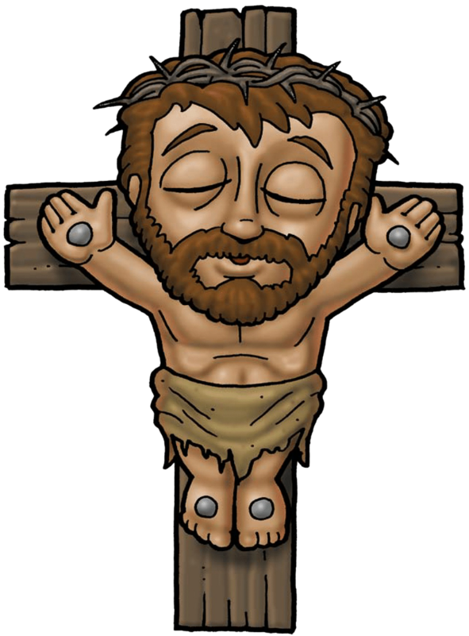
Hebrews1: 1-3
God spoke to our fathers by the prophets, 2 but in these last days He has spoken to us by His Son, … 3 He is the radiance of the glory of God and the exact imprint of his nature, and …

Slide 37
John 14: 7
If you had known Me, you would have known My Father also; from now on you know Him, and have seen Him." 8 Philip said to Him, "Lord, show us the Father, and it is enough for us." 9 Jesus said to him, "Have I been so long with you, and yet you have not come to know Me, Philip? He who has seen Me has seen the Father; …

Slide 38
Summary :
5 Reasons some don’t believe
7 Different views of God
4 Reasons to believe in God
The bible reveals God.

Slide 39

Psalms 14: 1 & 53: 1
The fool has said in his heart, "There is no God."

Slide 40
There is no greater topic for one’s personal worship than the existent God.

