Slide 1

Studies
In
Christianity

Slide 2
Private Worship #5
Walking Daily With God

Slide 3





Slide 4
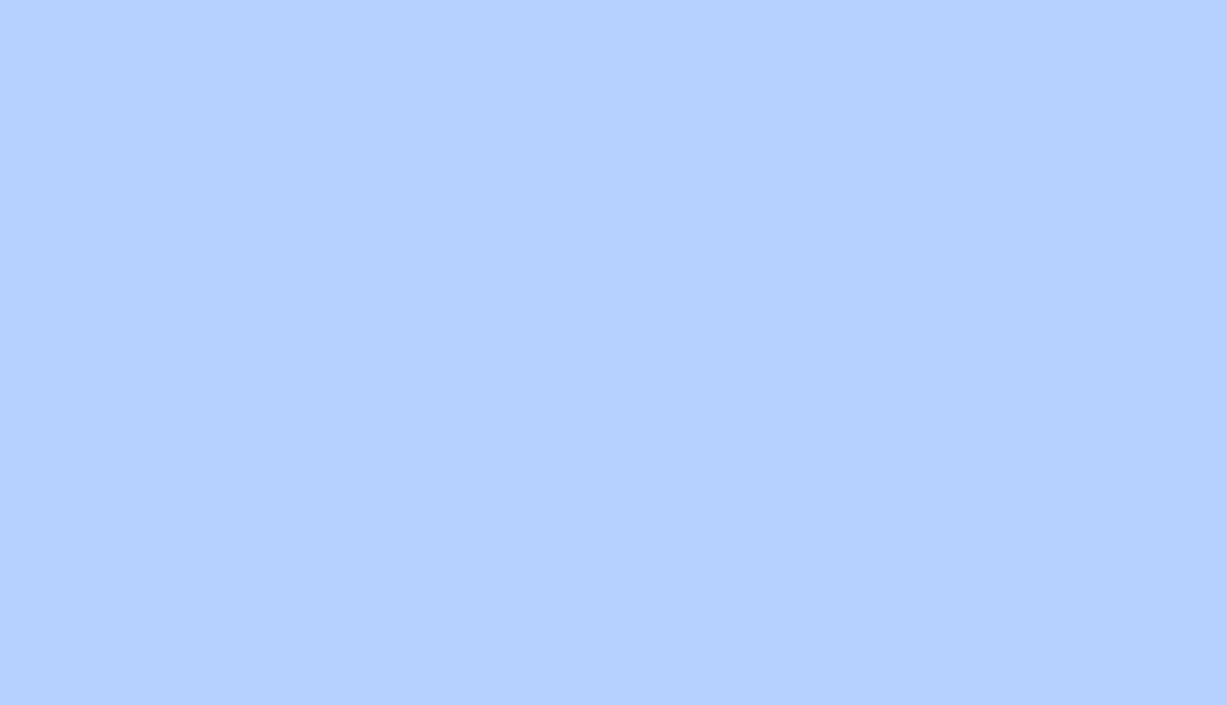
X-Factors for victory :
Be totally committed to winning
Approach the contest realistically
Do not become distracted

Slide 5

I. The easiest race to when
is one in which only one
contestant is racing.

Slide 6

Ephesians 6: 11
Put on the full armor of God, so that you will be able to stand firm against the schemes of the devil. 12 For our struggle is not against flesh and blood, but against the rulers, against the powers, against the world forces of this darkness, against the spiritual forces of wickedness in the heavenly places.

Slide 7
I Peter 5: 8
Be of sober spirit, be on the alert. Your adversary, the devil, prowls around like a roaring lion, seeking someone to devour. 9 But resist him, firm in your faith, knowing that the same experiences of suffering are being accomplished by your brethren who are in the world.

Slide 8
II Corinthians 4: 4
It is veiled to those who are perishing, 4 in whose case the god of this world has blinded the minds of the unbelieving so that they might not see the light of the gospel of the glory of Christ, who is the image of God.

Slide 9
John 8: 44
You are of your father the devil, and you want to do the desires of your father. He was a murderer from the beginning, and does not stand in the truth because there is no truth in him. Whenever he speaks a lie, he speaks from his own nature, for he is a liar and the father of lies.

Slide 10
I Peter 5: 8
Be of sober spirit, be on the alert. Your adversary,
the devil, prowls around like a roaring lion, seeking someone to devour.
I Peter 5: 9
But resist him, firm in your faith, knowing that the same experiences of suffering are being accomplished by your brethren who are in the world.
James 4: 7
Submit therefore to God. Resist the devil and
he will flee from you.

Slide 11
We must be aware of the
struggle and totally
committed to our victory.

Slide 12
II. We must approach our
warfare realistically.

Slide 13
I Corinthians 10: 12
Therefore let him who thinks he stands take heed that he does not fall.
II Corinthians 4: 4
It is veiled to those who are perishing, 4 in whose case the god of this world has blinded the minds of the unbelieving so that they might not see the light of the gospel of the glory of Christ, who is the image of God.

Slide 14
I John 5: 19
We know that we are of God, and that the whole world lies in the power of the evil one.
Jude 9
But Michael the archangel, when he disputed with the devil and argued about the body of Moses, did not dare pronounce against him a railing judgment, but said, " The Lord rebuke you!"

Slide 15

I Corinthians 10: 12
Therefore let him who thinks he stands take heed that he does not fall.

Slide 16
We must approach our
struggle against Satan
realistically.

Slide 17
III. We must not allow
ourselves to be
distracted from the
struggles we face.

Slide 18
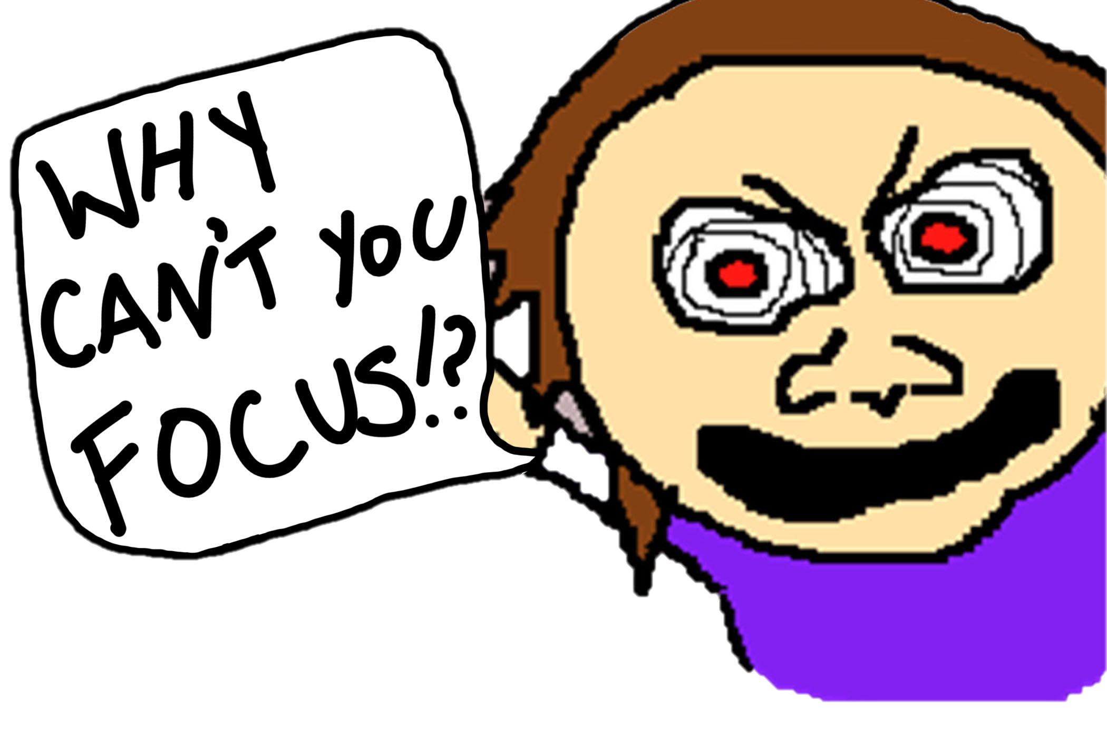
Life is a
distraction
as long as our
heart beats.

Slide 19

God will never
accept second
place in your
life.

Slide 20
Religious activities can
be a distraction.

Slide 21
Isaiah 29:13
Then the Lord said, "Because this people draw near with their words and honor Me with their lip service, but they remove their hearts far from Me, And their reverence for Me consists of tradition learned by rote,
Matthew 15: 7
You hypocrites, rightly did Isaiah prophesy of you: 8 'This people honors Me with their lips, but their heart is far away from Me.

Slide 22
I Samuel 13: 14
But now your kingdom shall not endure. The Lord has sought out for Himself a man after His own heart, and the Lord has appointed him as ruler over His people, because you have not kept what the Lord commanded you.

Slide 23
I Samuel 26: 11
The Lord forbid that I should stretch out my hand against the Lord's anointed; but now please take the spear that is at his head and the jug of water, and let us go.

Slide 24
Our lesson has been the
importance of staying
spiritually on target.
Remaining Committed
Resisting Realistically
Resolutely Undistracted

Slide 25

God will be first
in your life or He
will not be in it.

Slide 26
Am I seeking daily to
make my heart one
with God’s heart ?

Slide 27
Amos 3: 3
Can two walk together,
unless they are agreed?
Are you walking with God?

Slide 28


