Slide 1

Studies
In
Christianity

Slide 2
Private Worship #2
Meditation as Worship

Slide 3

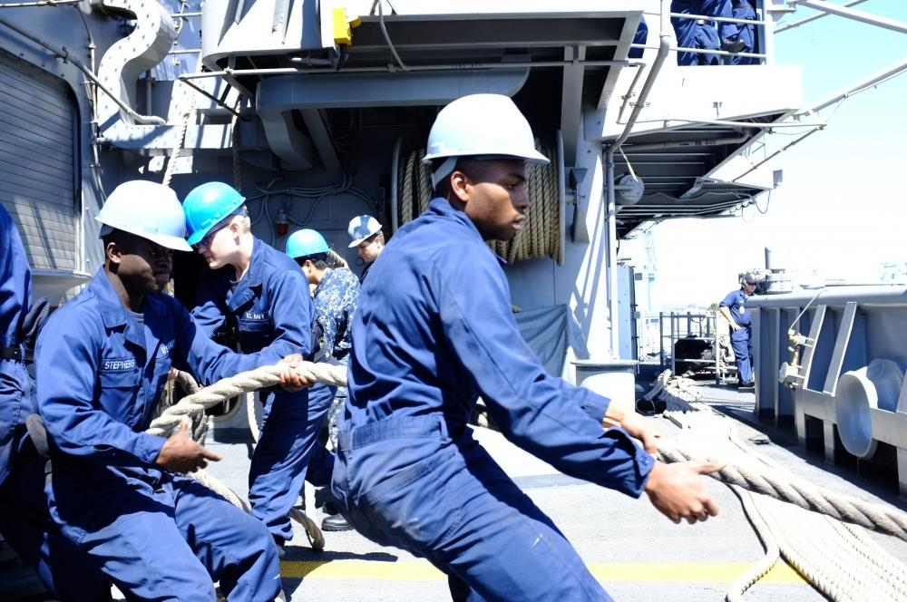
Private daily worship moors us to God.

Slide 4

Hebrews 2: 1
For this reason we must pay much closer attention to what we have heard, so that
we do not drift away from it.
I Timothy 6: 21
…the opposing arguments of what is falsely called "knowledge“ — 21 which some have professed and thus gone astray from the faith.

Slide 5
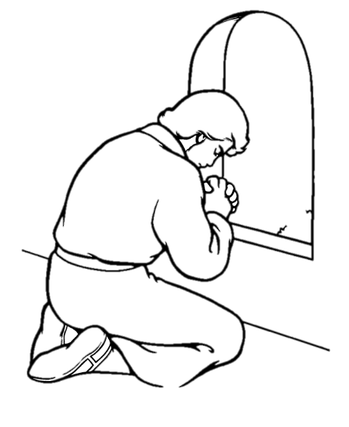
Daniel 6: 10
Now when Daniel knew that the document was signed, he entered his house (now in his roof chamber he had windows open toward Jerusalem); and he continued kneeling on his knees three times a day, praying and giving thanks before his God, as he had been doing previously.

Slide 6
Things that indicate drifting.
Neglectful of the word Lacking fellowship
Neglectful of prayer Don’t trust God
Insensitive to gospel Not repulsed by sin

Slide 7
God came to earth to save us;
we must now respond to Him.
James 4: 8
Draw near to God and He will draw near to you. Cleanse your hands, you sinners; and purify your hearts, you double-minded.

Slide 8
This lesson :
Meditation is commanded
Meditation has benefits
There is a reward for it.
A few applications

Slide 9

I. Meditation is commanded.

Slide 10
II Timothy 2: 7
Consider what I say, for the Lord will give you understanding in everything.
Consider : noieō
a. to perceive with the mind,
to have understanding
b. to think upon, heed,
ponder, consider

Slide 11
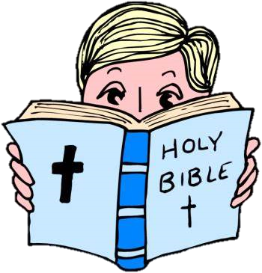
We must go beyond memorizing facts
From the bible.

Slide 12
Psalms 1:1
How blessed is the man who does not walk in the counsel of the wicked, nor stand in the path of sinners, nor sit in the seat of scoffers! 2 But his delight is in the law of the Lord, and in His law he meditates day and night. 3 He will be like a tree firmly planted by streams of water, which yields its fruit in its season and its leaf does not wither; and in whatever he does, he prospers.

Slide 13
Psalms 119: 97
O how I love Your law! It is my meditation all the day. 98 Your commandments make me wiser than my enemies, 99 I have more insight than all my teachers, for Your testimonies are my meditation.

Slide 14

What does it mean
to meditate ?
think deeply or
carefully about
Not This

Slide 15
II. Meditation has benefits.

Slide 16
II Timothy 2: 7
Consider what I say, for the Lord will give you understanding in everything.
Understanding : ( synesis ) Bringing things together, a putting together in the mind, hence: understanding, practical discernment, intellect
At Pittsburg there is a “synesis” of the Allegheny and Monongahela rivers to form the Ohio river which will eventually “synesis” with the Mississippi.

Slide 17
Philippians 1: 9
And this I pray, that your love may abound still more and more in real knowledge and all discernment, 10 so that you may approve the things that are excellent,

Slide 18
God must be the one to give
understanding / discernment.
II Timothy 2: 7b
for the Lord will give you understanding
Do you pray for it ?

Slide 19
III. There is a reward promised
for meditation.

Slide 20
II Timothy 2: 7
Consider what I say, for the Lord will give you understanding in everything.
Will we all reach the same level of understanding this side of Heaven ?
No.

Slide 21
IV. Let’s observe a few quick
points about application.

Slide 22
For learners :
Meditation is vital for learning
Sermons don’t end presentation
Understanding differs from facts
The Lord is the source of insight
Knowledge comes from study,
but goes beyond the technical
1.
2.
3.
4.
5.

Slide 23
For teachers :
1.
I can teach facts, but I cannot
give understanding.
The Lord’s teaching goes on after
my teaching is finished.
We must be confident that God
will work in His time.
2.
3.

Slide 24
Isaiah 55: 11
So will My word be which goes forth from My mouth; It will not return to Me empty, without accomplishing what I desire, and without succeeding in the matter for which I sent it.

Slide 25
Our goal is to lay up God’s word in
our hearts, but how do we do that.
Deuteronomy 11: 18
You shall therefore impress these words of mine on your heart and on your soul; and you shall bind them as a sign on your hand, and they shall be as frontals on your forehead.

Slide 26
It cannot be done without
meditating on His word.
Psalms 119: 15
I will meditate on Your precepts and regard Your ways. 16 I shall delight in Your statutes; I shall not forget Your word.

Slide 27
Our objective is to have
God’s word so integrated
in our thinking that it
guides our lives each day.

Slide 28
We want to be that person
who always instinctively
knows the right thing to do.

Slide 29
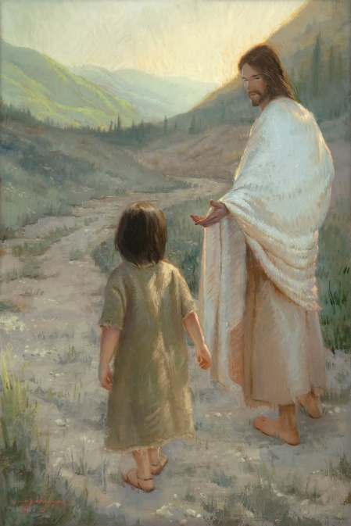
We want to be drawn so near to God
that we are walking with Him.
James 4: 8
Draw near to God and He will draw near to you. Cleanse your hands, you sinners; and purify your hearts, you double-minded.

Slide 30
Those who walk with God
always reach their destination.

