Slide 1

Facing A New Year Without Fear

Slide 2

Quarantined

Slide 3

Challenges
lay ahead
for 2021

Slide 4

We face political
challenges as
never before
in U.S. history.

Slide 5

I. By nature people are
afraid of the unknown.

Slide 6
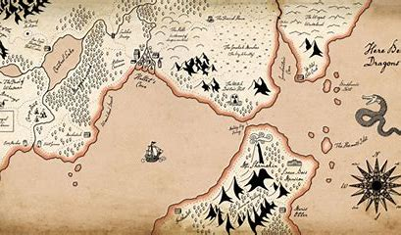



Slide 7

II Timothy 1: 7
For God gave us a spirit not of fear but of power and love and self-control. ( ESV )
John 14:27
Peace I leave with you; My peace I give to you; not as the world gives do I give to you. Do not let your heart be troubled, nor let it be fearful.

Slide 8
There are real reasons
to be afraid.
Acts 8: 3
But Saul began ravaging the church, entering house after house, and dragging off men and women, he would put them in prison. 4 Therefore, those who had been scattered went about preaching the word.

Slide 9
I Kings 19: 14
Then he said, "I have been very zealous for the Lord, the God of hosts; for the sons of Israel have forsaken Your covenant, torn down Your altars and killed Your prophets with the sword. And I alone am left; and they seek my life, to take it away."

Slide 10
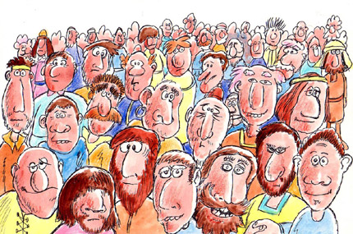
I Kings 19: 18
Yet I will leave 7,000 in Israel, all the knees that have not bowed to Baal and every mouth that has not kissed him."

Slide 11
II. Most fear is caused
by lack of faith.

Slide 12
Revelation 21: 8
But for the cowardly and unbelieving and abominable and murderers and immoral persons and sorcerers and idolaters and all liars, their part will be in the lake that burns with fire and brimstone, which is the second death."

Slide 13
Numbers 13: 30
Then Caleb quieted the people before Moses and said, "We should by all means go up and take possession of it, for we will surely overcome it." 31 But the men who had gone up with him said, "We are not able to go up against the people, for they are too strong for us." 32 So they gave out to the sons of Israel a bad report of the land which they had spied out, saying, "The land through which we have gone, in spying it out, is a land that devours its inhabitants; and all the people whom we saw in it are men of great size.

Slide 14
Our promises should
eliminate fear.
Salvation
Mark 16: 16
He who has believed and has been baptized shall be saved; but he who has disbelieved shall be condemned.

Slide 15
A home in Heaven.
John 14: 2b
…for I go to prepare a place for you. 3 If I go and prepare a place for you, I will come again and receive you to Myself, that where I am, there you may be also.

Slide 16
Our needs provided
Matthew 6: 33
But seek first His kingdom and His righteousness, and all these things will be added to you.

Slide 17
Divine companionship
Matthew 28: 19
Go therefore and make disciples of all the nations, baptizing them in the name of the Father and the Son and the Holy Spirit, 20 teaching them to observe all that I commanded you; and lo, I am with you always, even to the end of the age.

Slide 18
Never forsaken by God
Hebrews 13: 5
Make sure that your character is free from the love of money, being content with what you have; for He Himself has said, "I will never desert you, nor will I ever forsake you," 6 so that we confidently say, "The Lord is my helper, I will not be afraid. What will man do to me?"

Slide 19
III. Every promise made
to man is dependent
upon his obedience
in some way.

Slide 20
Salvation
Mark 16: 16
He who has believed and has been baptized shall be saved; but he who has disbelieved shall be condemned.

Slide 21
Home in Heaven
John 14: 2b
…for I go to prepare a place for you. 3 If I go and prepare a place for you, I will come again and receive you to Myself, that where I am,
there you may be also.
John 14: 1
Do not let your heart be troubled; believe in God, believe also in Me.

Slide 22
Needs Provided
Matthew 6: 33
But seek first His kingdom and His righteousness, and all these things will be added to you.

Slide 23
Blessing of Jesus with us
Matthew 28: 19
Go therefore and make disciples of all the nations, baptizing them in the name of the Father and the Son and the Holy Spirit, 20 teaching them to observe all that I commanded you; and lo, I am with you always, even to the end of the age.

Slide 24
God’s Blessing / protection
Hebrews 13: 5
Make sure that your character is free from the love of money, being content with what you have; for He Himself has said, "I will never desert you, nor will I ever forsake you," 6 so that we confidently say, "The Lord is my helper, I will not be afraid. What will man do to me?"

Slide 25
Colossians 3: 5
Therefore consider the members of your earthly body as dead to immorality, impurity, passion, evil desire, and greed, which amounts to idolatry.
I John 2: 15
Do not love the world nor the things in the world. If anyone loves the world, the love of the Father is not in him.

Slide 26
Matthew 6: 24
No one can serve two masters; for either he will hate the one and love the other, or he will be devoted to one and despise the other. You cannot serve God and wealth.

Slide 27
Hebrews 13: 5
Make sure that your character is free from the love of money, being content with what you have;
I Timothy 6: 6
But godliness actually is a means of great gain when accompanied by contentment. 7 For we have brought nothing into the world, so we cannot take anything out of it either. 8 If we have food and covering, with these we shall be content.

Slide 28

The future is uncertain.
There may be dragons.

Slide 29
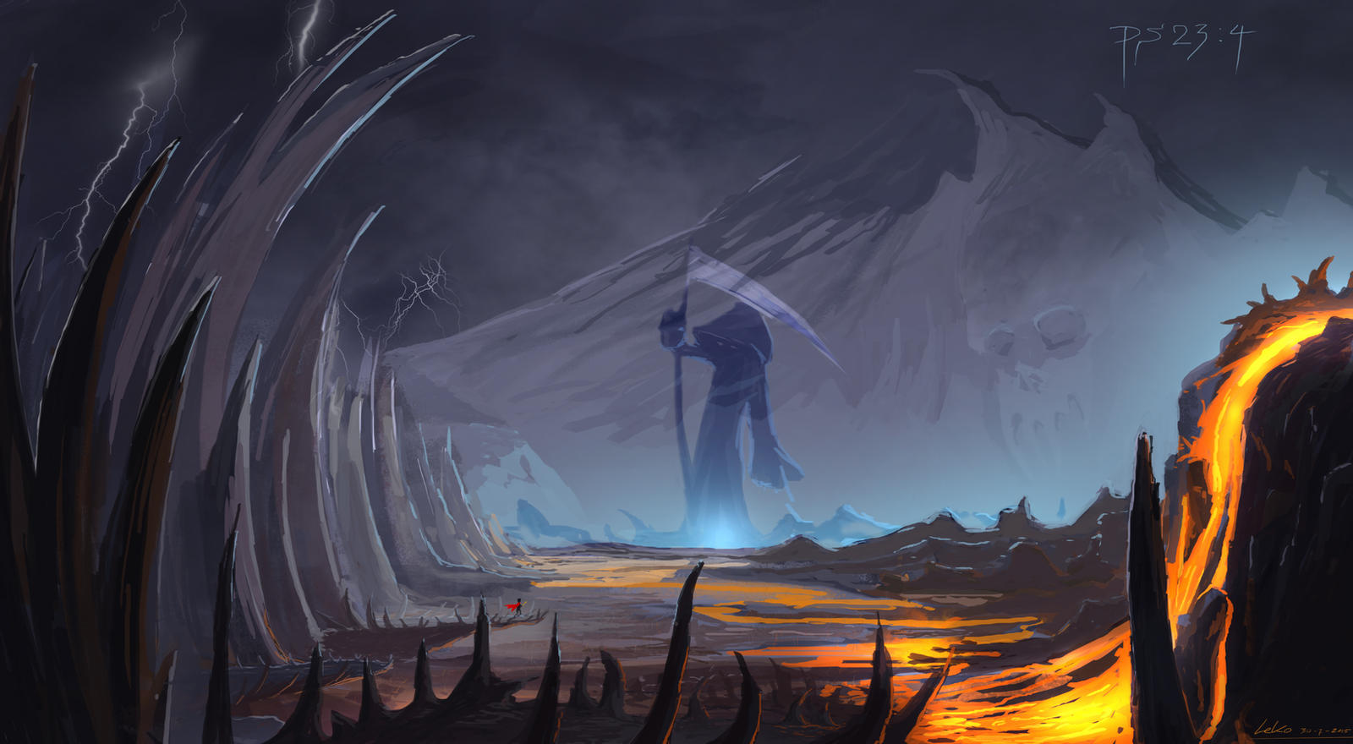
Psalm 23
Even though I walk through the valley of the shadow of death, I fear no evil, for You are with me;

Slide 30
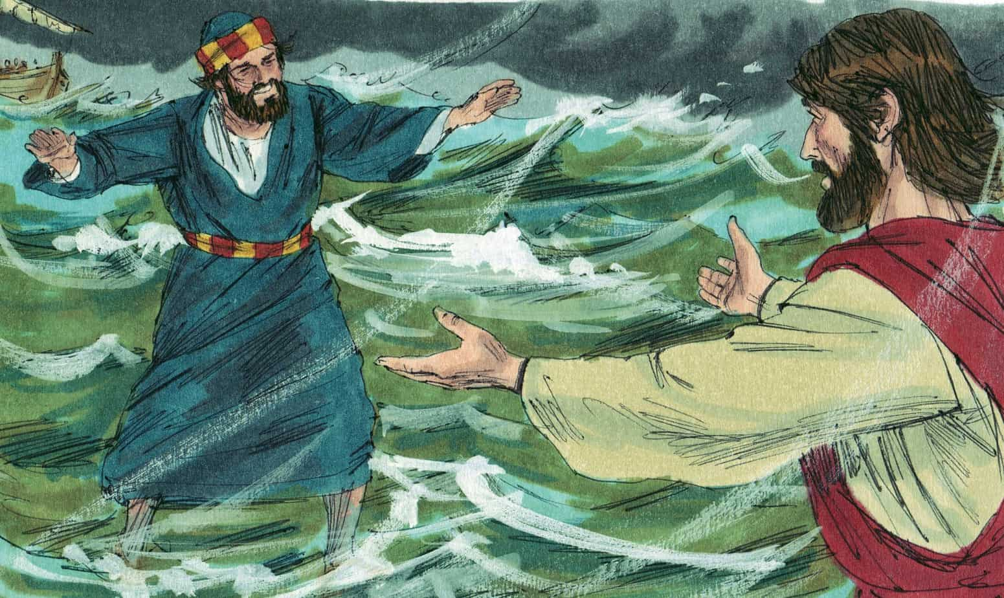

Slide 31


