Slide 1

Studies
In
Christianity

Slide 2
Prayer - A Private Disciple #3
Praise – the First Key to Prayer

Slide 3

God willing, this lesson will include :
1. Prayer is a learned skill.
2. Christians are welcomed as family.
3. Prayer must be worshipful.
4. Prayer must be daily.
5. Prayer must engender penitence.
6. The prayer must be a supplicant.
7. Prayer must be persistent.

Slide 4
Our previous lesson on personal prayer:
1. Prayer should contain great praise.
2. Prayers should be made with gladness.
3. Prayers should be to the glory of God.
* Praise is an overarching theme of scriptures.

Slide 5

I. Every Prayer should
contain great praise.

Slide 6

Psalms 145: 1
I will extol You, my God, O King, And I will bless Your name forever and ever. 2 Every day I will bless You, and I will praise Your name forever and ever. 3 Great is the Lord, and highly to be praised, And His greatness is unsearchable.

Slide 7
Psalms 148: 1
Praise the Lord! Praise the Lord from the heavens; Praise Him in the heights! 2 Praise Him, all His angels; Praise Him, all His hosts!

Slide 8
Exodus 15: 11
Who is like You among the gods, O Lord?
Who is like You, majestic in holiness,
Awesome in praises, working wonders?
I Chronicles 16: 25
For great is the Lord, and greatly to be praised; …
Jeremiah 20: 13
Sing to the Lord, praise the Lord! …
Daniel 2: 23
To You, O God of my fathers, I give thanks and praise,

Slide 9
Psalms 146: 1 – Praise the Lord! Praise the Lord, O my soul! 2 I will praise the Lord while I live; …
Psalms 147: 1 – Praise the Lord! For it is good to sing praises to our God; For it is pleasant and praise is becoming.
Psalms 135: 1 – Praise the Lord! Praise the name of the Lord; Praise Him, O servants of the Lord,
Psalms 96: 4 – For great is the Lord and greatly to be praised

Slide 10
II. Our praise should be glad
praise and an expression
of joy.

Slide 11
I Peter 1: 8
and though you have not seen Him, you love Him, and though you do not see Him now, but believe in Him, you greatly rejoice with joy inexpressible and full of glory,
Philippians 4: 4
Rejoice in the Lord always; again I will say, rejoice!

Slide 12
Psalms 27: 6b
And I will offer in His tent sacrifices with shouts of joy; I will sing, yes, I will sing praises to the Lord.
Psalms 32: 11
Be glad in the Lord and rejoice, you righteous ones; And shout for joy, all you who are upright in heart.

Slide 13
Psalms 70: 4
Let all who seek You rejoice and be glad in You; And let those who love Your salvation say continually, "Let God be magnified."
Psalms 63: 5
My soul is satisfied as with marrow and fatness, And my mouth offers praises with joyful lips.

Slide 14
Whether we do it in a group or individually, worship is a joyous occasion.
Psalms #122: 1
I was glad when they said to me,
"Let us go to the house of the Lord."

Slide 15
Habakkuk 3: 17
Though the fig tree should not blossom And there be no fruit on the vines, Though the yield of the olive should fail And the fields produce no food, Though the flock should be cut off from the fold And there be no cattle in the stalls, 18 Yet I will exult in the Lord, I will rejoice in the God of my salvation.

Slide 16
Job 1: 20
Then Job arose and tore his robe and shaved his head, and he fell to the ground and worshiped. 21 He said, "Naked I came from my mother's womb, And naked I shall return there. The Lord gave and the Lord has taken away. Blessed be the name of the Lord."

Slide 17
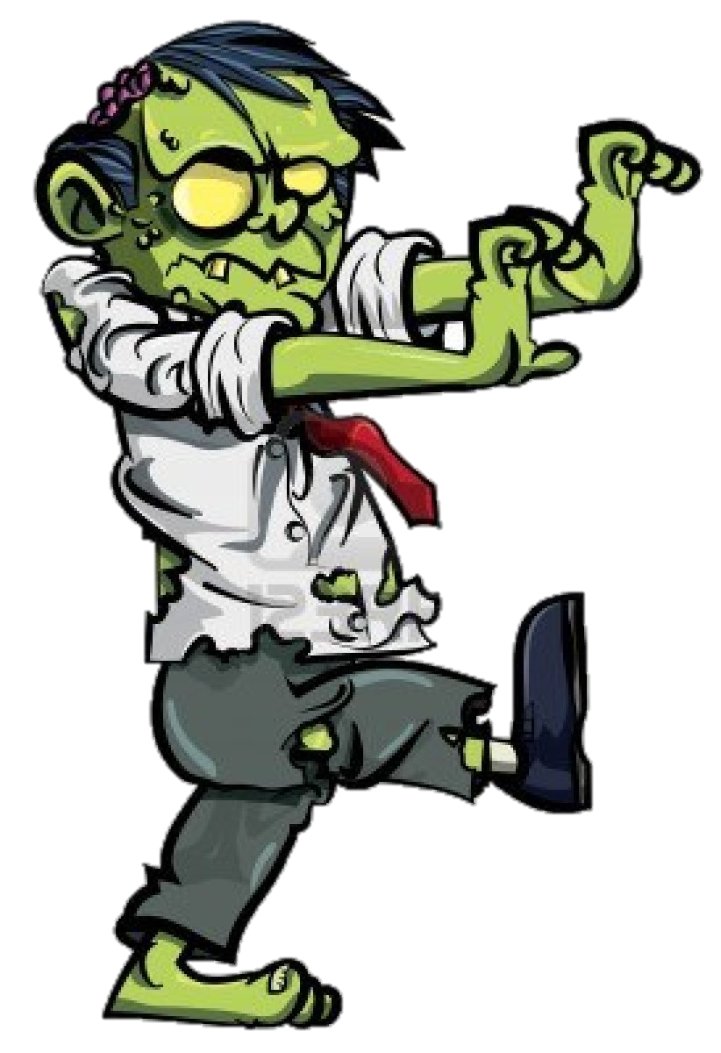

The saddest site in the whole world
is to see a Christian who has lost
his or her joy of being in Christ.

Slide 18
III. Praising God is a
source glory.

Slide 19
Psalms 148: 13
Let them praise the name of the Lord, For His name alone is exalted; His glory is above earth and heaven.
Psalms 145: 5
On the glorious splendor of Your majesty And on Your wonderful works, I will meditate.

Slide 20
John 1:14
And the Word became flesh, and dwelt among us, and we saw His glory, glory as of the only begotten from the Father, full of grace and truth.
John 2:11
This beginning of His signs Jesus did in Cana of Galilee, and manifested His glory, and His disciples believed in Him.

Slide 21
John 17: 24
Father, I desire that they also, whom You have given Me, be with Me where I am, so that they may see My glory which You have given Me, for You loved Me before the foundation of the world.
Luke 9: 32
Now Peter and his companions had been overcome with sleep; but when they were fully awake, they saw His glory and the two men standing with Him.

Slide 22
II Peter 1: 17
For when He received honor and glory from God the Father, such an utterance as this was made to Him by the Majestic Glory, "This is My beloved Son with whom I am well-pleased"
Luke 5:25
Immediately he got up before them, and picked up what he had been lying on, and went home glorifying God. 26 They were all struck with astonishment and began glorifying God; and they were filled with fear, saying, "We have seen remarkable things today."

Slide 23
Matthew 5:16
Let your light shine before men in such a way that they may see your good works, and glorify your Father who is in heaven.
I Corinthians 6: 20
For you have been bought with a price: therefore glorify God in your body.

Slide 24
Psalms 66: 2
Sing the glory of His name; Make His praise glorious. 3 Say to God, "How awesome are Your works! Because of the greatness of Your power Your enemies will give feigned obedience to You. 4 All the earth will worship You, And will sing praises to You; They will sing praises to Your name.
Psalms 21: 13
Be exalted, O Lord, in Your strength;

Slide 25
Psalms 48: 10 – As is Your name, O God, So is Your praise to the ends of the earth; Your right hand is full of righteousness.
Psalms 148: 13 – Let them praise the name of the Lord, For His name alone is exalted; His glory is above earth and heaven.
Psalms 99: 2 – The Lord is great in Zion, And He is exalted above all the peoples. 3 Let them praise Your great and awesome name; Holy is He.

Slide 26
What should our praise be ?
1. Great
2. Glad
3. Glorious

Slide 27
Challenge :
become comfortable with the language of praise.

