Slide 1

Studies
In
Christianity

Slide 2
Prayer - A Private Disciple #1
Some Fundamentals of Prayer

Slide 3

Our series on worship included :
1. Worship is universal
2. We assemble for worship on Sunday
3. What constitutes an assembly.
4. The “5 acts of worship”
5. Other things we do after the 5 acts
6. The offering is an act of worship
7. Our assemblies are a time of joy.
8. How to pray in the assembly.

Slide 4
Our series on worship included :
1. Worship is universal
2. We assemble for worship on Sunday
I Corinthians 11: 18 – For, in the first place, when you come together as a church, I hear that divisions exist among you; and in part I believe it.
3. What constitutes an assembly.
4. The “5 acts of worship”
5. Other things we do after the 5 acts
6. The offering is an act of worship
7. Our assemblies are a time of joy.
8. How to pray in the assembly.

Slide 5
Our series on worship included :
1. Worship is universal
2. We assemble for worship on Sunday
3. What constitutes an assembly.
4. The “5 acts of worship”
5. Other things we do after the 5 acts
6. The offering is an act of worship
7. Our assemblies are a time of joy.
8. How to pray in the assembly.

Slide 6
Our series on worship included :
1. Worship is universal
2. We assemble for worship on Sunday
3. What constitutes an assembly.
4. The “5 acts of worship”
5. Other things we do after the 5 acts
6. The offering is an act of worship
7. Our assemblies are a time of joy.
8. How to pray in the assembly.

Slide 7
Our series on worship included :
1. Worship is universal
2. We assemble for worship on Sunday
3. What constitutes an assembly.
4. The “5 acts of worship”
5. Other things we do after the 5 acts
6. The offering is an act of worship
7. Our assemblies are a time of joy.
8. How to pray in the assembly.

Slide 8
Our series on worship included :
1. Worship is universal
2. We assemble for worship on Sunday
3. What constitutes an assembly.
4. The “5 acts of worship”
5. Other things we do after the 5 acts
6. The offering is an act of worship
7. Our assemblies are a time of joy.
8. How to pray in the assembly.

Slide 9
Our series on worship included :
5. Other things we do after the 5 acts
6. The offering is an act of worship
7. Our assemblies are a time of joy.
Hebrews 13: 15 –
Through Him then, let us continually offer up a sacrifice of praise to God, that is, the fruit of lips that give thanks to His name.
8. How to pray in the assembly.

Slide 10
Our series on worship included :
1. Worship is universal
2. We assemble for worship on Sunday
3. What constitutes an assembly.
4. The “5 acts of worship”
5. Other things we do after the 5 acts
6. The offering is an act of worship
7. Our assemblies are a time of joy.
8. How to pray in the assembly.

Slide 11
Some fundamentals of prayer:
1. The character of prayer?
2. Why should we pray?
3. Some precondition of prayer.

Slide 12

I. What is the character
of our prayer life?

Slide 13

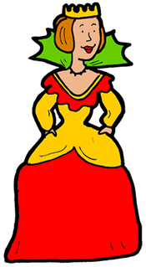
Ephesians 3: 11
This was according to the eternal purpose that he has realized in Christ Jesus our Lord, 12 in whom we have boldness and access with confidence through our faith in him. ( ESV )
Hebrews 4: 16
Therefore let us draw near with confidence to the throne of grace, so that we may receive mercy and find grace to help in time of need.

Slide 14
Matthew 6: 7
And when you are praying, do not use meaningless repetition as the Gentiles do, for they suppose that they will be heard for their many words. 8 So do not be like them; for your Father knows what you need before you ask Him.

Slide 15
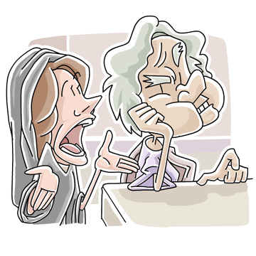
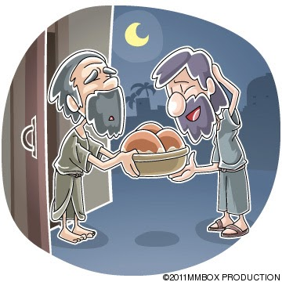

Slide 16
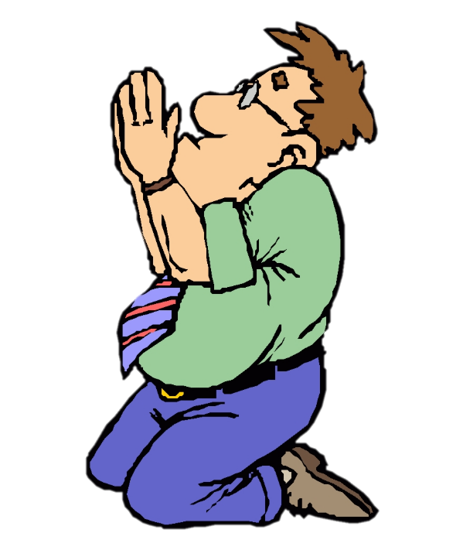

I Thessalonians 5: 16
Rejoice always; 17 pray without ceasing; 18 in everything give thanks; for this is God's will for you in Christ Jesus.

Slide 17
II. Why should we pray?

Slide 18
Ephesians 6: 18
With all prayer and petition pray at all times in the Spirit, and with this in view, be on the alert with all perseverance and petition for all the saints, 19 and pray on my behalf, that utterance may be given to me in the opening of my mouth, to make known with boldness the mystery of the gospel, 20 for which I am an ambassador in chains; that in proclaiming it I may speak boldly, as I ought to speak.

Slide 19
Mark 14: 37
And He came and found them sleeping, and said to Peter, "Simon, are you asleep? Could you not keep watch for one hour? 38 Keep watching and praying that you may not come into temptation; the spirit is willing, but the flesh is weak."

Slide 20
John 14: 13
Whatever you ask in My name, that will I do, so that the Father may be glorified in the Son. 14 If you ask Me anything in My name, I will do it.
( John 16:24 .. ask in my name )

Slide 21
John 16: 23
In that day you will not question Me about anything. Truly, truly, I say to you, if you ask the Father for anything in My name, He will give it to you. 24 Until now you have asked for nothing in My name; ask and you will receive, so that your joy may be made full.

Slide 22
III. What are some of
the preconditions
for prayer?

Slide 23
Matthew 21: 21
And Jesus answered and said to them, "Truly I say to you, if you have faith and do not doubt, you will not only do what was done to the fig tree, but even if you say to this mountain, 'Be taken up and cast into the sea,' it will happen. 22 "And all things you ask in prayer, believing, you will receive."

Slide 24
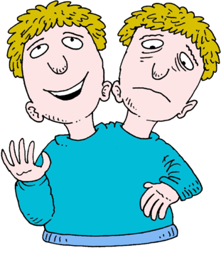
James 1: 6
But he must ask in faith without any doubting, for the one who doubts is like the surf of the sea, driven and tossed by the wind. 7 For that man ought not to expect that he will receive anything from the Lord, 8 being a double-minded man, unstable in all his ways.

Slide 25
I John 5: 14
This is the confidence which we have before Him, that, if we ask anything according to His will, He hears us. 15 And if we know that He hears us in whatever we ask, we know that we have the requests which we have asked from Him.

Slide 26
Luke 9: 54 – When His disciples James and John saw this, they said, "Lord, do You want us to command fire to come down from heaven and consume them?" 55 But He turned and rebuked them, [ and said, "….]
James 5: 16 – Therefore, confess your sins to one another, and pray for one another so that you may be healed. The effective prayer of a righteous man can accomplish much.

Slide 27
Prayer is the most precious
privilege given to Christians
Take full advantage of it !

