Slide 1

Studies
In
Christianity

Slide 2
Christian Worship #7
Offering Sacrifices to God

Slide 3

Etymology of the word “worship:
a. The Greek “proskuneó” = worship =
to kiss the ground, pay complete obeisance
b. The Old English “weorthscipe” = worship
= to attribute honor, reverence paid to

Slide 4

The previous lessons discussed :
1. Praying together
2. Public reading
3. Announcements
4. Encouraging
5. Orderly interaction
1. Call to Worship
2. Singing differently
3. Preaching styles
4. Giving as worship
5. For Communion

Slide 5
This lessons centers on attitudes:
1. Joy because we can approach God.
2. Gratitude for all God has done for us.
3. Longing to be near to our Lord.

Slide 6

I. The assembly of the saints
should be a time of great
JOY.

Slide 7


Any occasion the gather at God’s
Feet and worship is great joy.
Psalm 122: 1
I was glad when they said to me,
"Let us go to the house of the Lord."

Slide 8
Luke 1: 39 – Now at this time Mary arose and went in a hurry to the hill country, to a city of Judah, 40 and entered the house of Zacharias and greeted Elizabeth. 41 When Elizabeth heard Mary's greeting, the baby leaped in her womb; and Elizabeth was filled with the Holy Spirit. 42 And she cried out with a loud voice and said, "Blessed are you among women, and blessed is the fruit of your womb! 43 "And how has it happened to me, that the mother of my Lord would come to me? 44 "For behold, when the sound of your greeting reached my ears, the baby leaped in my womb for joy.

Slide 9
Luke 2: 10
But the angel said to them, " Do not be afraid; for behold, I bring you good news of great joy which will be for all the people; 11 for today in the city of David there has been born for you a Savior, who is Christ the Lord.

Slide 10
Matthew 2: 10
When they saw the star, they rejoiced exceedingly with great joy. 11 After coming into the house they saw the Child with Mary His mother; and they fell to the ground and worshiped Him.

Slide 11
Hebrews 13: 2
… let us run with endurance the race that is set before us, 2 fixing our eyes on Jesus, the author and perfecter of faith, who for the joy set before Him endured the cross, despising the shame, and has sat down at the right hand of the throne of God.

Slide 12
Hebrews 10: 34
For you showed sympathy to the prisoners and accepted joyfully the seizure of your property, knowing that you have for yourselves a better possession and a lasting one. 35 Therefore, do not throw away your confidence, which has a great reward.

Slide 13
Nehemiah 12: 43
And the singers sang, with Jezrahiah their leader, 43 and on that day they offered great sacrifices and rejoiced because God had given them great joy, even the women and children rejoiced, so that the joy of Jerusalem was heard from afar.

Slide 14
God has filled our hearts with JOY
that goes beyond happiness.
Psalm 4: 7
You have put more JOY in my heart than they have when their grain and wine abound. ( ESV )

Slide 15

The Christian’s JOY is based
upon his salvation and his
relationship with God.

Slide 16
Isaiah 35: 10
And the ransomed of the Lord will return and come with joyful shouting to Zion, with everlasting joy upon their heads. They will find gladness and joy, and sorrow and sighing will flee away.
Psalm #51: 12
Restore to me the joy of Your salvation And sustain me with a willing spirit.

Slide 17
Romans 5: 1
Therefore, having been justified by faith, we have peace with God through our Lord Jesus Christ, 2 through whom also we have obtained our introduction by faith into this grace in which we stand; and we exult in hope of the glory of God.

Slide 18
The assembly of the saints is a
time to rejoice in our common
salvation.
Psalm #107: 2
Let the redeemed of the Lord say so,
Whom He has redeemed from the hand of the adversary.

Slide 19
II. We come into the assembly
with a deep feeling of
gratitude.

Slide 20
The scriptures urge us to express
gratitude for our salvation.
Psalm 95: 1
O come, let us sing for joy to the Lord, Let us shout joyfully to the rock of our salvation. 2 Let us come before His presence with thanksgiving, Let us shout joyfully to Him with psalms.

Slide 21
Colossians 3: 15
Let the peace of Christ rule in your hearts, to which indeed you were called in one body; and be thankful. 16 Let the word of Christ richly dwell within you, with all wisdom teaching and admonishing one another with psalms and hymns and spiritual songs, singing with thankfulness in your hearts to God. 17 Whatever you do in word or deed, do all in the name of the Lord Jesus, giving thanks through Him to God the Father.

Slide 22
Ephesians 5: 19
… be filled with the Spirit, 19 speaking to one another in psalms and hymns and spiritual songs, singing and making melody with your heart to the Lord; 20 always giving thanks for all things in the name of our Lord Jesus Christ to God, even the Father;

Slide 23
Giving heart felt thanks is offering
a spiritual sacrifice to God.
Hebrews 13: 15
Through Him then, let us continually offer up a sacrifice of praise to God, that is, the fruit of lips that give thanks to His name.

Slide 24
Philippians 4: 4
Rejoice in the Lord always; again I will say, rejoice! 5 Let your gentle spirit be known to all men. The Lord is near. 6 Be anxious for nothing, but in everything by prayer and supplication with thanksgiving let your requests be made known to God.

Slide 25

Our assembly should be a joyful
acknowledgement of all God
has done for us.

Slide 26
III. Collectively, our desire is to
be permanently assembled
in the presence of God.

Slide 27
We are Christians because
we desire to be with God
eternally through Christ.

Slide 28
Before Christ we were separated
from God by our sins.
Romans 6: 23
For the wages of sin is death, but the free gift of God is eternal life in Christ Jesus our Lord.
( cf - Eph. 2: 12 , Isa. 59: 1-2 )

Slide 29
John 14: 1
Do not let your heart be troubled; believe in God, believe also in Me. 2 In My Father's house are many dwelling places; if it were not so, I would have told you; for I go to prepare a place for you. 3 If I go and prepare a place for you, I will come again and receive you to Myself, that where I am, there you may be also.

Slide 30
When we are in the assembly
we are with our eternal family.
Hebrews 9: 27
And inasmuch as it is appointed for men to die once and after this comes judgment,

Slide 31
II Timothy 3: 15
and that from childhood you have known the sacred writings which are able to give you the wisdom that leads to salvation through faith which is in Christ Jesus.

Slide 32
II Thessalonians 1: 7b
… when the Lord Jesus will be revealed from heaven with His mighty angels in flaming fire, 8 dealing out retribution to those who do not know God and to those who do not obey the gospel of our Lord Jesus. 9 These will pay the penalty of eternal destruction, away from the presence of the Lord and from the glory of His power, 10a when He comes to be glorified in His saints on that day,

Slide 33

Like those outside of Christ
Christians who return to sin
or turn to false religions will
be eternally lost, separated
from God eternally.

Slide 34

The assembly of the saints
should always be a joyful
celebration of salvation.

Slide 35
Question:
Will you rejoice to see the
Lord coming in the air with
His host of mighty angels?

Slide 36
Jesus wants to save you if
you will surrender your life
to Him and obey His gospel.

Slide 37


Slide 38
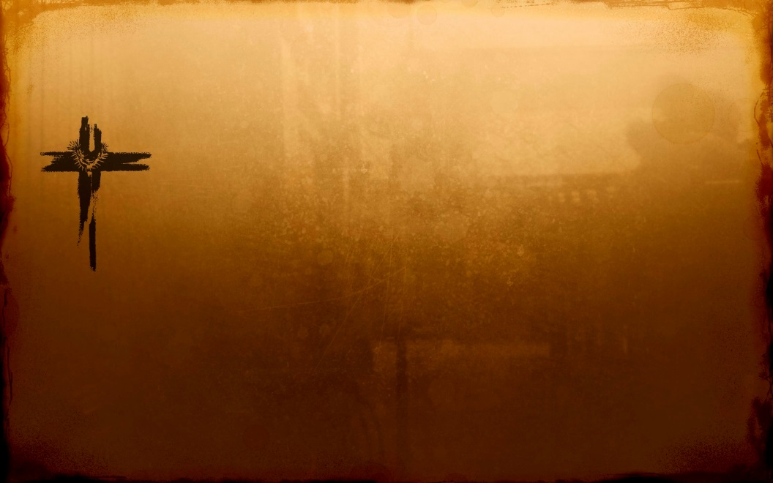
Psalms 122: 1
I was glad when they said to me,
Let us go to the house of the Lord.

Slide 39

Psalms 95: 1-8
1 O come, let us sing for joy to the Lord,
Let us shout joyfully to the rock of our salvation.
2 Let us come before His presence with thanksgiving,
Let us shout joyfully to Him with psalms.
3 For the Lord is a great God
And a great King above all gods,
4 In whose hand are the depths of the earth,
The peaks of the mountains are His also.

Slide 40
Psalms 95: 1-8 … continuation
5 The sea is His, for it was He who made it,
And His hands formed the dry land.
6 Come, let us worship and bow down,
Let us kneel before the Lord our Maker.
7 For He is our God,
And we are the people of His pasture and the sheep of His hand.

Slide 41
Psalms 51: 1-13
1 Be gracious to me, O God, according to Your lovingkindness;
According to the greatness of Your compassion blot out my transgressions.
2 Wash me thoroughly from my iniquity
And cleanse me from my sin.
3 For I know my transgressions,
And my sin is ever before me.
4 Against You, You only, I have sinned And done what is evil in Your sight, So that You are justified when You speak And blameless when You judge.

Slide 42
Psalms 51: 1-13 … continuation
5. Behold, I was brought forth in iniquity, And in sin my mother conceived me.
6 Behold, You desire truth in the innermost being,
And in the hidden part You will make me know wisdom. 7 Purify me with hyssop, and I shall be clean; Wash me, and I shall be whiter than snow. 8 Make me to hear joy and gladness,
Let the bones which You have broken rejoice. 9 Hide Your face from my sins And blot out all my iniquities.

Slide 43
Psalms 51: 1-13 … continuation
10 Create in me a clean heart, O God, And renew a steadfast spirit within me.
11 Do not cast me away from Your presence
And do not take Your Holy Spirit from me.
12 Restore to me the joy of Your salvation And sustain me with a willing spirit.
13 Then I will teach transgressors Your ways, And sinners will be converted to You.

Slide 44
Love God with all your heart.

Slide 45
