Slide 1

Studies
In
Christianity

Slide 2
Christian Worship #5b
Beyond the Five Acts ( part 2 )

Slide 3

Last Lesson we considered :
1. Using a call to worship.
2. Americans sing differently
3. Variations in Preaching
4. Giving as an act of worship
5. Communion is the reason

Slide 4
Last Lesson we considered :
1. Using a call to worship.
2. Americans sing differently
3. Variations in Preaching
4. Giving as an act of worship
5. Communion is the reason

Slide 5

Colossians 3: 16
Let the word of Christ richly dwell within you, with all wisdom teaching and admonishing one another with psalms and hymns and spiritual songs, singing with thankfulness in your hearts to God.

Slide 6
Ephesians 5: 19
… be filled with the Spirit, 19 speaking to one another in psalms and hymns and spiritual songs, singing and making melody with your heart to the Lord; …

Slide 7
Last Lesson we considered :
1. Using a call to worship.
2. Americans sing differently
3. Variations in Preaching
4. Giving as an act of worship
5. Communion is the reason

Slide 8
Last Lesson we considered :
1. Using a call to worship.
2. Americans sing differently
3. Variations in Preaching
4. Giving as an act of worship
5. Communion is the reason

Slide 9
Last Lesson we considered :
1. Using a call to worship.
2. Americans sing differently
3. Variations in Preaching
4. Giving as an act of worship
5. Communion is the reason

Slide 10
I Corinthians 11: 20
Therefore when you meet together,
it is not to eat the Lord's Supper,
Acts 20: 7
On the first day of the week, when we were gathered together to break bread, Paul began talking to them, intending to leave the next day, and he prolonged his message until midnight.

Slide 11

This lesson will discuss :
1. Praying in the assembly
2. The public reading of scripture
3. Announcements and honoring
4. Encouraging and edifying
5. Proper and orderly interaction

Slide 12

I. Both in and out of the
assembly, prayer has
always been characteristic
of God’s people.

Slide 13
Acts 2: 42
They were continually devoting themselves to the apostles' teaching and to fellowship, to the breaking of bread and to prayer.
Acts 12: 5
So Peter was kept in the prison, but prayer for him was being made fervently by the church to God.

Slide 14
Luke 18: 6
And the Lord said, "Hear what the unrighteous judge said; 7 now, will not God bring about justice for His elect who cry to Him day and night, and will He delay long over them?
Philippians 4: 6
Be anxious for nothing, but in everything by prayer and supplication with thanksgiving let your requests be made known to God.

Slide 15
Hebrews 13: 15
Through Him then, let us continually offer up a sacrifice of praise to God, that is, the fruit of lips that give thanks to His name.
Romans 12:12
rejoicing in hope, persevering in tribulation, devoted to prayer,

Slide 16
II. We read Scripture in
the assembly.

Slide 17
Reading scripture is commanded
I Timothy 4: 13
Until I come, give attention to the public reading of Scripture, to exhortation and teaching.
Cannot -vs- will not

Slide 18

III. Announcements and
also honor each other.

Slide 19
A time for interaction and sharing.
Romans 12: 14
Rejoice with those who rejoice, and weep with those who weep.
Romans 12: 10
Be devoted to one another in brotherly love; give preference to one another in honor;

Slide 20
IV. Our commonness generates
positive interaction which
will encourage and edify.

Slide 21
Hebrews 10: 23
Let us hold fast the confession of our hope without wavering, for He who promised is faithful; 24 and let us consider how to stimulate one another to love and good deeds, 25 not forsaking our own assembling together, as is the habit of some, but encouraging one another; and all the more as you see the day drawing near.

Slide 22
I Corinthians 14: 26
What is the outcome then, brethren? When you assemble, each one has a psalm, has a teaching, has a revelation, has a tongue, has an interpretation. Let all things be done for edification.

Slide 23

How do we identify ?
How do we build up ?
How about you ?
How about us ?
Direct interaction is key.

Slide 24
We conduct ourselves
orderly and with respect
emphasizing love.

Slide 25
The context reveals what is meant by :
I Corinthians 14: 40
But all things must be done properly and in an orderly manner.
“Orderly manner” is also culturally defined.

Slide 26
I Corinthians 14: 23
Therefore if the whole church assembles together and all speak in tongues, and ungifted men or unbelievers enter, will they not say that you are mad? 24 But if all prophesy, and an unbeliever or an ungifted man enters, he is convicted by all, he is called to account by all; 25 the secrets of his heart are disclosed; and so he will fall on his face and worship God, declaring that God is certainly among you.

Slide 27
Assembled worship honors God.
God designed them to be horizontal.
They are a gift, never a burden.

Slide 29
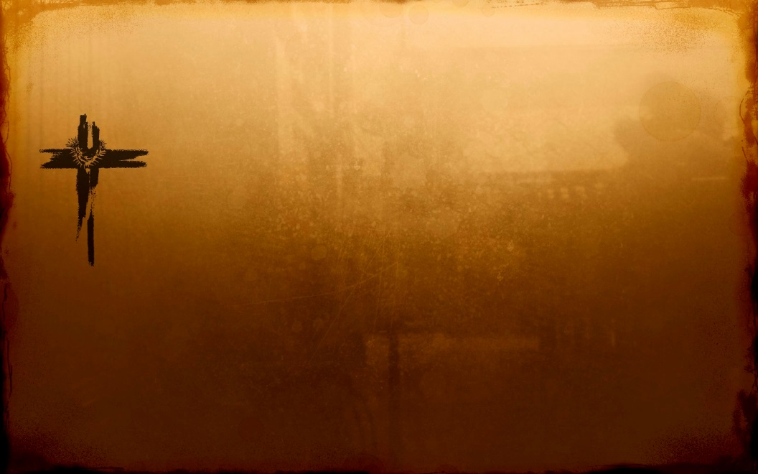
Psalms 122: 1
I was glad when they said to me,
Let us go to the house of the Lord.

Slide 30
Psalms 22: 25-31
25 From You comes my praise in the great assembly;
I shall pay my vows before those who fear Him.
26 The afflicted will eat and be satisfied;
Those who seek Him will praise the Lord.
Let your heart live forever!
27 All the ends of the earth will remember and turn to the Lord,
And all the families of the nations will worship before You.
28 For the kingdom is the Lord's
And He rules over the nations.

Slide 31
Psalms 22: 25-31 … continuation
29 All the prosperous of the earth will eat and worship,
All those who go down to the dust will bow before Him,
Even he who cannot keep his soul alive.
30 Posterity will serve Him;
It will be told of the Lord to the coming generation.
31 They will come and will declare His righteousness
To a people who will be born, that He has performed it.

Slide 32
Hebrews 10: 19-31
19 Therefore, brethren, since we have confidence to enter the holy place by the blood of Jesus, 20 by a new and living way which He inaugurated for us through the veil, that is, His flesh, 21 and since we have a great priest over the house of God, 22 let us draw near with a sincere heart in full assurance of faith, having our hearts sprinkled clean from an evil conscience and our bodies washed with pure water. 23 Let us hold fast the confession of our hope without wavering, for He who promised is faithful; 24 and let us consider how to

Slide 33
Hebrews 10: 19-31 … continuation
stimulate one another to love and good deeds, 25 not
forsaking our own assembling together, as is the habit of some, but encouraging one another; and all the more as you see the day drawing near.
26 For if we go on sinning willfully after receiving the knowledge of the truth, there no longer remains a sacrifice for sins, 27 but a terrifying expectation of judgment and the fury of a fire which will consume the adversaries. 28 Anyone who has set aside the Law of Moses dies without mercy on the

Slide 34
Hebrews 10: 19-31 … continuation
testimony of two or three witnesses. 29 How much severer punishment do you think he will deserve who has trampled
under foot the Son of God, and has regarded as unclean the blood of the covenant by which he was sanctified, and has insulted the Spirit of grace? 30 For we know Him who said, "Vengeance is Mine, I will repay." and again, "The Lord will judge his people." 31 It is a terrifying thing to fall into the hands of the living God.

Slide 35

Love God with all your heart.

Slide 36
