Slide 1

Studies
In
Christianity

Slide 2
Christian Worship #5
Beyond the Five Acts

Slide 3

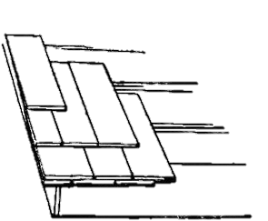
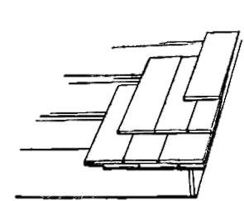
My approach to preaching
Expository – vs - Topical

Slide 4


Where do we find the
“5 Acts” of worship?

Slide 5


How do we do worship?

Slide 6


I. The Call to Worship

Slide 7
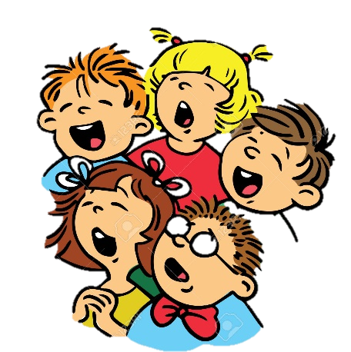

II. American congregations
do singing differently
than some cultures.

Slide 8

Colossians 3: 16
Let the word of Christ richly dwell within you, with all wisdom teaching and admonishing one another with psalms and hymns and spiritual songs, singing with thankfulness in your hearts to God.

Slide 9
Ephesians 5: 19
… be filled with the Spirit, 19 speaking to one another in psalms and hymns and spiritual songs, singing and making melody with your heart to the Lord; …

Slide 10
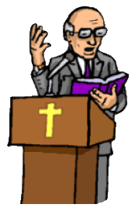
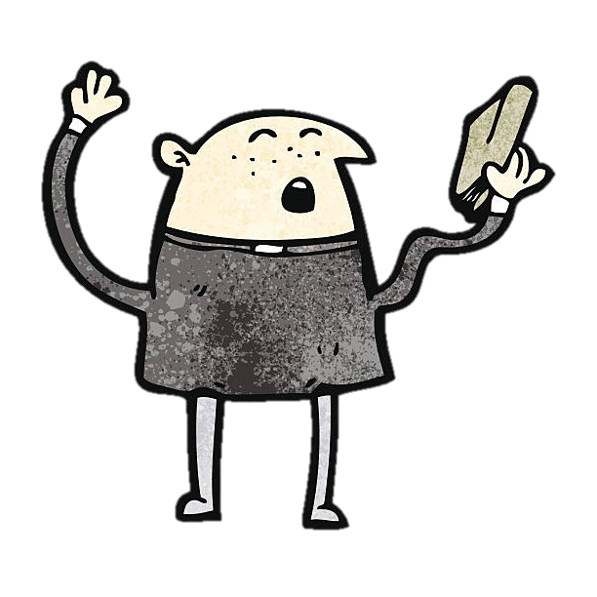
III. Preaching can be done
done in many ways.

Slide 11
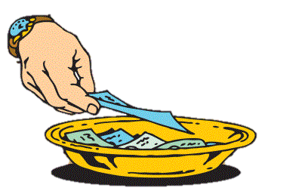
IV. Giving is often disrespected
as an act of worship.

Slide 12
V. We come together
specifically to eat
the Lord’s Supper.

Slide 13
I Corinthians 11: 20
Therefore when you meet together,
it is not to eat the Lord's Supper,
Acts 20: 7
On the first day of the week, when we were gathered together to break bread, Paul began talking to them, intending to leave the next day, and he prolonged his message until midnight.

Slide 14
I Corinthians 16: 1
Now concerning the collection for the saints, as I directed the churches of Galatia, so do you also. 2 On the first day of every week each one of you is to put aside and save, as he may prosper, so that no collections be made when I come.

Slide 15
Acts 20: 7
On the first day of the week, when we were gathered together to break bread, Paul began talking to them, intending to leave the next day, and he prolonged his message until midnight.

Slide 16
I Corinthians 11: 26
For as often as you eat this bread and drink the cup, you proclaim the Lord's death until He comes.
I Corinthians 11: 27
Therefore whoever eats the bread or drinks the cup of the Lord in an unworthy manner, shall be guilty of the body and the blood of the Lord. 28 But a man must examine himself, and in so doing he is to eat of the bread and drink of the cup. 29 For he who eats and drinks, eats and drinks judgment to himself if he does not judge the body rightly.

Slide 17

This lesson has addressed :
1. Using a call to worship
2. Singing in the assembly
3. Styles of preaching
4. Weekly offerings
5. Eating the Lord’s Supper

Slide 18
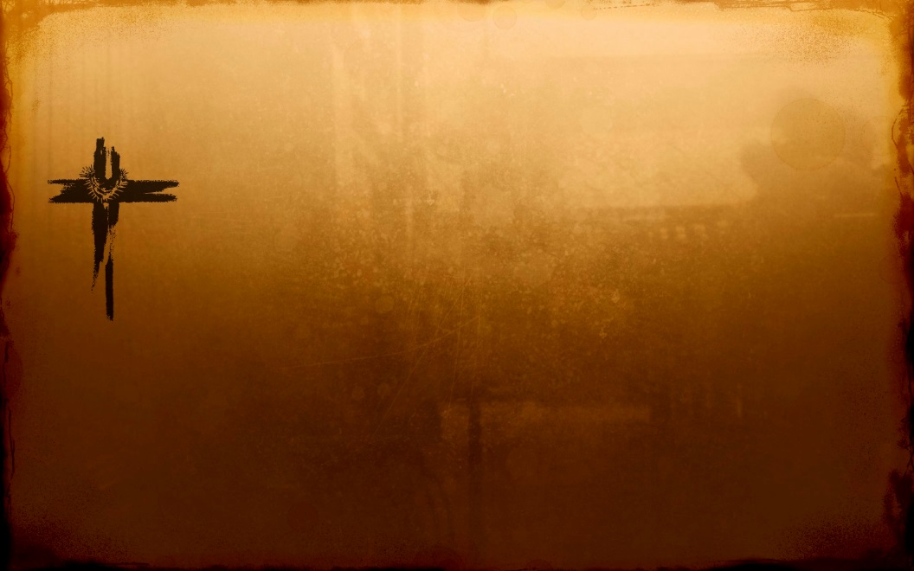
Psalms 122: 1
I was glad when they said to me,
Let us go to the house of the Lord.

Slide 19
Psalms 22: 25-31
25 From You comes my praise in the great assembly;
I shall pay my vows before those who fear Him.
26 The afflicted will eat and be satisfied;
Those who seek Him will praise the Lord.
Let your heart live forever!
27 All the ends of the earth will remember and turn to the Lord,
And all the families of the nations will worship before You.
28 For the kingdom is the Lord's
And He rules over the nations.

Slide 20
Psalms 22: 25-31 … continuation
29 All the prosperous of the earth will eat and worship,
All those who go down to the dust will bow before Him,
Even he who cannot keep his soul alive.
30 Posterity will serve Him;
It will be told of the Lord to the coming generation.
31 They will come and will declare His righteousness
To a people who will be born, that He has performed it.

Slide 21
Hebrews 10: 19-31
19 Therefore, brethren, since we have confidence to enter the holy place by the blood of Jesus, 20 by a new and living way which He inaugurated for us through the veil, that is, His flesh, 21 and since we have a great priest over the house of God, 22 let us draw near with a sincere heart in full assurance of faith, having our hearts sprinkled clean from an evil conscience and our bodies washed with pure water. 23 Let us hold fast the confession of our hope without wavering, for He who promised is faithful; 24 and let us consider how to

Slide 22
Hebrews 10: 19-31 … continuation
stimulate one another to love and good deeds, 25 not
forsaking our own assembling together, as is the habit of some, but encouraging one another; and all the more as you see the day drawing near.
26 For if we go on sinning willfully after receiving the knowledge of the truth, there no longer remains a sacrifice for sins, 27 but a terrifying expectation of judgment and the fury of a fire which will consume the adversaries. 28 Anyone who has set aside the Law of Moses dies without mercy on the

Slide 23
Hebrews 10: 19-31 … continuation
testimony of two or three witnesses. 29 How much severer punishment do you think he will deserve who has trampled
under foot the Son of God, and has regarded as unclean the blood of the covenant by which he was sanctified, and has insulted the Spirit of grace? 30 For we know Him who said, "Vengeance is Mine, I will repay." and again, "The Lord will judge his people." 31 It is a terrifying thing to fall into the hands of the living God.

Slide 24


