Slide 1

Studies
In
Christianity

Slide 2

The Christian Lifestyle #15
Christians Are Compulsively Evangelistic

Slide 3

Ephesians 5: 7
Therefore do not be partakers with them; 8 for you were formerly darkness, but now you are Light in the Lord; walk as children of Light.
Ephesians 5: 11
Do not participate in the unfruitful deeds of darkness, but instead even expose them;

Slide 4
John 3: 19
This is the judgment, that the Light has come into the world, and men loved the darkness rather than the Light, for their deeds were evil. 20 "For everyone who does evil hates the Light, and does not come to the Light for fear that his deeds will be exposed.

Slide 5
II Corinthians 6: 14
Do not be bound together with unbelievers; for what partnership have righteousness and lawlessness, or what fellowship has light with darkness? 15 Or what harmony has Christ with Belial, or what has a believer in common with an unbeliever?

Slide 6
The Christians IS Love.
1. Christians love God.
2. Christians Love others.
3. Christians Love self.
4. Christians Love the unborn.
5. Christians Love the lost.

Slide 7

I. Christians love God.
( Father, Son, Holy Spirit )

Slide 8
I John 4: 8
The one who does not love does not know God, for God is love.
I John 4:16
We have come to know and have believed the love which God has for us. God is love, and the one who abides in love abides in God, and God abides in him.

Slide 9
Matthew 22: 37
And He said to him, " 'You shall love the Lord your God with all your heart, and with all your soul, and with all your mind.' 38 This is the great and foremost commandment.

Slide 10
John 3: 16
For God so loved the world, that He gave His only begotten Son, that whoever believes in Him shall not perish, but have eternal life.
Romans 5: 8
But God demonstrates His own love toward us, in that while we were yet sinners, Christ died for us.

Slide 11
II. Christians love
themselves.

Slide 12
When Jesus instructed us to love our neighbors, He also commanded us to love ourselves.
Matthew 22: 39
The second is like it, 'You shall love your neighbor as yourself.

Slide 13

One’s relationship with himself is the foundation
of all his relationships.

Slide 14
III. Christians love others,
i.e., their neighbor.

Slide 15
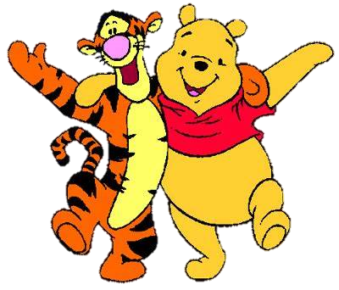
Christians
share a
special
bond

Slide 16
John 13: 34
A new commandment I give to you, that you love one another, even as I have loved you, that you also love one another. 35 By this all men will know that you are My disciples, if you have love for one another."

Slide 17
I Peter 2: 17
Honor all people, love the brotherhood, fear God, honor the king.
Luke 10: 29
But wishing to justify himself, he said to Jesus, "And who is my neighbor?"

Slide 18
John 13: 29
For some were supposing, because Judas had the money box, that Jesus was saying to him, "Buy the things we have need of for the feast"; or else, that he should give something to the poor.

Slide 19
IV. Christians love the
unborn.

Slide 20
Exodus 21: 22
If men struggle with each other and strike a woman with child so that she gives birth prematurely, yet there is no injury, he shall surely be fined as the woman's husband may demand of him, and he shall pay as the judges decide. 20 But if there is any further injury, then you shall appoint as a penalty life for life, 24 eye for eye, tooth for tooth, hand for hand, foot for foot, 25 burn for burn, wound for wound, bruise for bruise.

Slide 21

Psa. 139: 13
For You formed my inward parts; You wove me in my mother's womb. 14 I will give thanks to You, for I am fearfully and wonderfully made; wonderful are Your works, and my soul knows it very well.

Slide 22
Jeremiah 1: 4
Now the word of the Lord came to me saying, 5 "Before I formed you in the womb I knew you, and before you were born I consecrated you; I have appointed you a prophet to the nations."
Galatians 1: 15
But when God, who had set me apart even from my mother's womb and called me through His grace, was pleased 16 to reveal His Son

Slide 23
An unborn child can even worship.
Luke 1: 41
When Elizabeth heard Mary's greeting, the baby leaped in her womb; and Elizabeth was filled with the Holy Spirit.

Slide 24
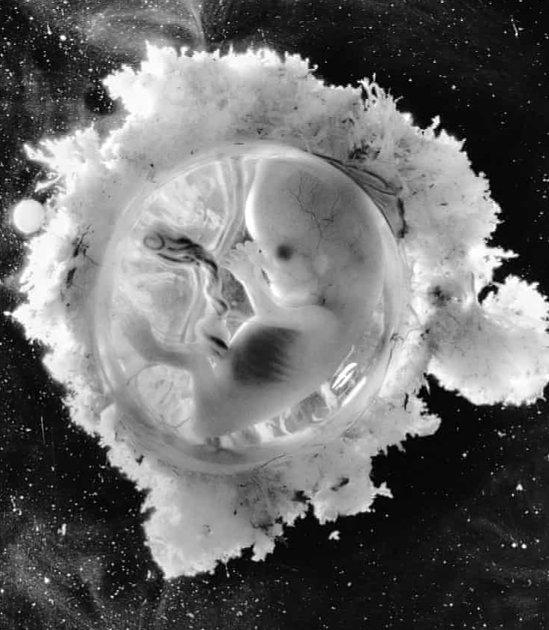
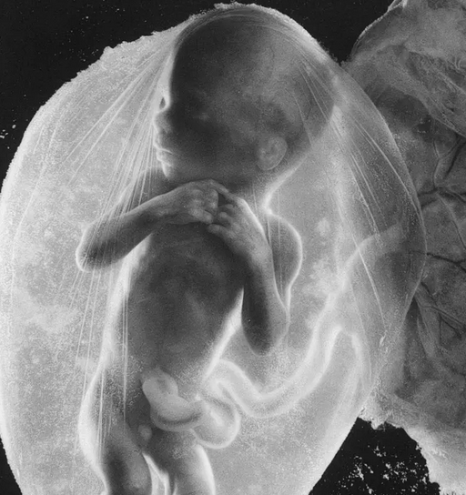
18 weeks
13 weeks

Slide 25
V. Christians love the
lost.

Slide 26
God has proven His love for man.
Romans 5: 8
But God demonstrates His own love toward us, in that while we were yet sinners, Christ died for us.

Slide 27
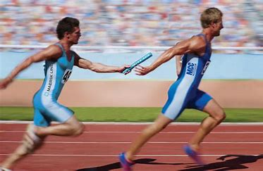
John 3: 16
For God so loved the world, that He gave His only begotten Son,
Will we run with it ?
Mark 10: 45
For even the Son of Man did not come to be served, but to serve, and to give His life a ransom for many.

Slide 28
Mark 16: 15
And He said to them, "Go into all the world and proclaim the gospel to all creation. 16 He who has believed and has been baptized shall be saved; but he who has disbelieved shall be condemned.
Matthew 10:7
And as you go, preach, saying, ' The kingdom of heaven is at hand.'

Slide 29
The Christians IS love.
1. We love God.
2. We Love others.
3. We Love self.
4. We Love the unborn.
5. We Love the lost.

Slide 31
Lesson Text :

Slide 32
Lesson Text :
Luke 10: 30-37
30 Jesus replied and said, "A man was going down from Jerusalem to Jericho, and fell among robbers, and they stripped him and beat him, and went away leaving him half dead. 31 And by chance a priest was going down on that road, and when he saw him, he passed by on the other side. 32 Likewise a Levite also, when he came to the place and saw him, passed by on the other side. 33 But a Samaritan, who was on a journey, came upon him; and when he saw him, he felt compassion, 34 and came to him and bandaged up his wounds, pouring oil and wine on them; and he put him on his
own beast, and brought him to an inn and took care of him.
Continued …

Slide 33
Lesson Text :
Luke 10: 30-37 … Continuation
35 On the next day he took out two denarii and gave them to the innkeeper and said, 'Take care of him; and whatever more you spend, when I return I will repay you.' 36 Which of these three do you think proved to be a neighbor to the man who fell into the robbers' hands?" 37 And he said, "The one who showed mercy toward him." Then Jesus said to him, "Go and do the same."
I John 4: 7-17
7 Beloved, let us love one another, for love is from God; and everyone who loves is born of God and knows God. 8 The
Continued …

Slide 34
Lesson Text :
I John 4: 7-17 … Continuation
one who does not love does not know God, for God is love.
9 By this the love of God was manifested in us, that God has sent His only begotten Son into the world so that we might live through Him. 10 In this is love, not that we loved God, but that He loved us and sent His Son to be the propitiation for our sins. 11 Beloved, if God so loved us, we also ought to love one another. 12 No one has seen God at any time; if we love one another, God abides in us, and His love is perfected in us. 13 By this we know that we abide in Him and He in us, because He has given us of His Spirit. 14 We have seen
Continued …

Slide 35
Lesson Text :
I John 4: 7-17 … Continuation
and testify that the Father has sent the Son to be the Savior of the world.
15 Whoever confesses that Jesus is the Son of God, God abides in him, and he in God. 16 We have come to know and have believed the love which God has for us. God is love, and the one who abides in love abides in God, and God abides in him. 17 By this, love is perfected with us, so that we may have confidence in the day of judgment; because as He is, so also are we in this world.

Slide 36
The End

