Slide 1

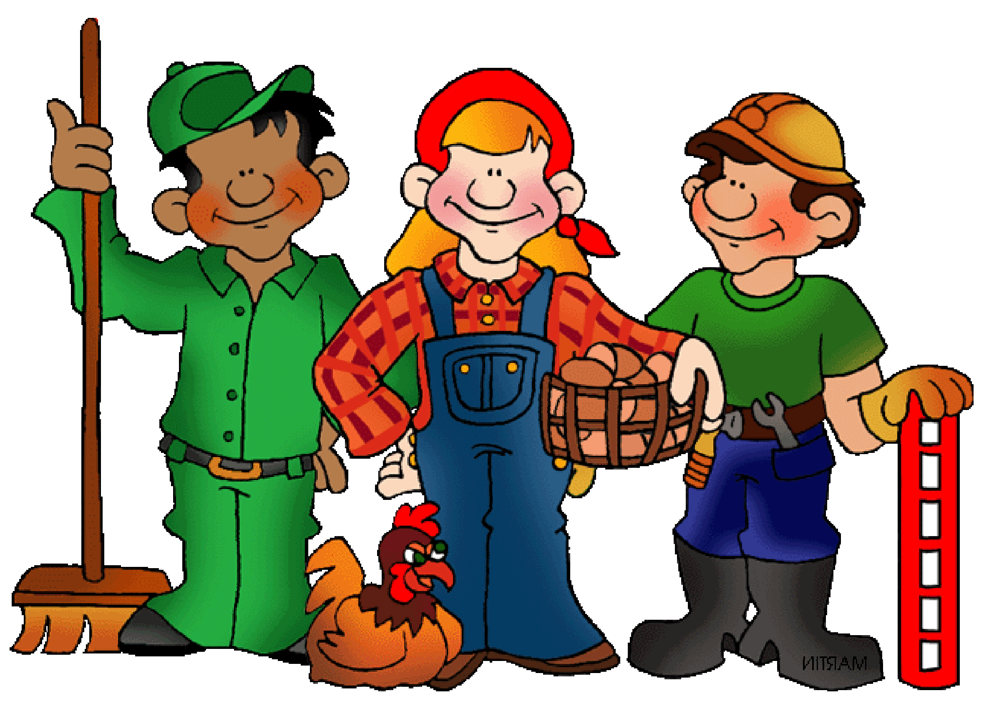
Everyday Labor

Slide 2



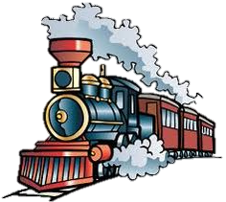

1894

Slide 3

In recognition of Labor Day
we will observe four
scriptural points about labor.
1. God made man to work.
2. Jesus requires us to work for Him.
3. Our work for God is not FOR salvation.
4. Our work can be evangelistic or not.

Slide 4

I. God created man
to work.

Slide 5

Genesis 2: 15
Then the Lord God took the man and put him into the garden of Eden to cultivate it and keep it.

Slide 6
Exodus 34: 21
You shall work six days, but on the seventh day
you shall rest; even during plowing time and
harvest you shall rest.
Leviticus 23: 3
For six days work may be done, but on the
seventh day there is a sabbath of complete rest,
a holy convocation. You shall not do any work;
it is a sabbath to the Lord in all your dwellings.
Compare: Exod 20:9-10, 23:12 – Six days you shall labor,
31:1, Deut. 5: 13-16

Slide 7
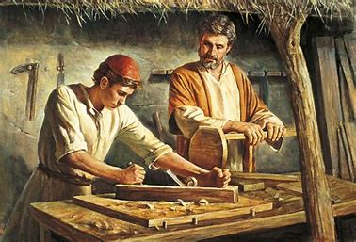
Mark 6: 3 –
Is not this the carpenter, the
son of Mary, and brother of
James and Joses and Judas
and Simon? Are not His sisters
here with us?"
I Thessalonians 2: 9
For you recall, brethren, our labor and hardship,
how working night and day so as not to be a burden
to any of you, we proclaimed to you the gospel of God.

Slide 8
II Thessalonians 3: 10
For even when we were with you, we used to give you this order: if anyone is not willing to work, then he is not to eat, either. 11 For we hear that some among you are leading an undisciplined life, doing no work at all, but acting like busybodies.
12 Now such persons we command and exhort in the Lord Jesus Christ to work in quiet fashion and eat their own bread.

Slide 9


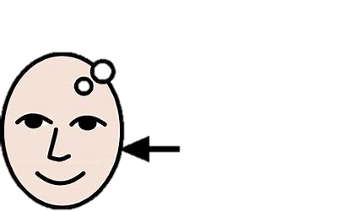
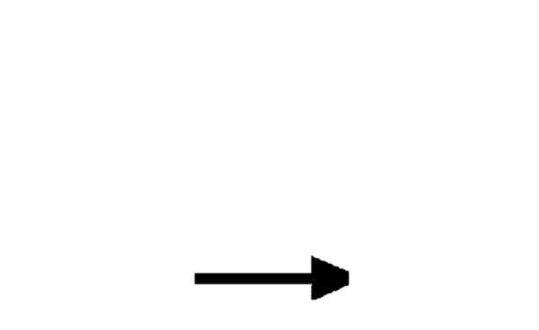
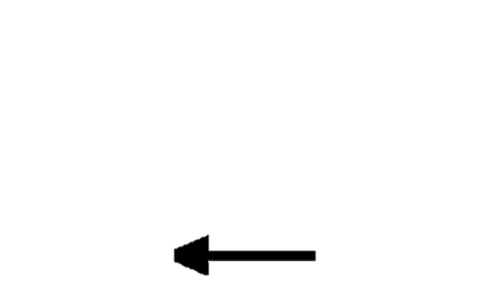
Ephesians 4: 28
He who steals must steal no longer; but rather he must labor, performing with his own hands what is good, so that he will have something to share with one who has need.

Slide 10
The mantra of the early settlers.
Proverbs 10: 4
Poor is he who works with a negligent hand,
But the hand of the diligent makes rich.
Ecclesiastes 5: 12
The sleep of the working man is pleasant, whether he eats little or much; but the full stomach of the rich man does not allow him to sleep.

Slide 11


Ecclesiastes 9: 10
Whatever your hand finds to do, do it with all your might; for there is no activity or planning or knowledge or wisdom in Sheol where you are going.

Slide 12
II. Jesus requires that
we work for Him.

Slide 13
Jesus told many parables
that demand action, e.g.,
The Good Samaritan
The Master’s capital
The unfaithful servant

Slide 14
Our Master is on a journey …
John 14:2
… I go to prepare a place for you …
Romans 8: 33
Who will bring a charge against God's elect? God is the one who justifies; 34 who is the one who condemns? Christ Jesus is He who died, yes, rather who was raised, who is at the right hand of God, who also intercedes for us.

Slide 15
Mark 16: 15 –
And He said to them, "Go into all the world and preach the gospel to all creation. 16 " He who has believed and has been baptized shall be saved; but he who has disbelieved shall be condemned. … 19 So then, when the Lord Jesus had spoken to them, He was received up into heaven and sat down at the right hand of God.

Slide 16


John 15: 2
Every branch in Me that does not bear fruit, He takes away; and every branch that bears fruit, He prunes it so that it may bear more fruit.
John 15: 8
My Father is glorified by this, that you bear much fruit, and so prove to be My disciples.

Slide 17
Romans 1:13
I do not want you to be unaware, brethren, that often I have planned to come to you (and have been prevented so far) so that I may obtain some fruit among you also, even as among the rest of the Gentiles.
Romans 7: 4
Therefore, my brethren, you also were made to die to the Law through the body of Christ, so that you might be joined to another, to Him who was raised from the dead, in order that we might bear fruit for God.

Slide 18
Ephesians 2:10
For we are His workmanship, created in Christ Jesus for good works, which God prepared beforehand so that we would walk in them.
I Corinthians 15: 58
Therefore, my beloved brethren, be steadfast, immovable, always abounding in the work of the Lord, knowing that your toil is not in vain in the Lord.

Slide 19
III. Our work in the Lord
is not FOR salvation.

Slide 20
Ephesians 2:8
For by grace you have been saved through faith; and that not of yourselves, it is the gift of God; 9 not as a result of works, so that no one may boast.
I John 1: 6–2:2 … Jesus is our constant advocate
Romans 8: 1
Therefore there is now no condemnation for those who are in Christ Jesus. 2 For the law of the Spirit of life in Christ Jesus has set you free from the law of sin and of death.

Slide 21
Romans 5: 12
Therefore, just as through one man sin entered into the world, and death through sin, and so death spread to all men, because all sinned — 13 for until the Law sin was in the world, but sin is not imputed when there is no law.
Romans 4: 5
But to the one who does not work, but believes in Him who justifies the ungodly, his faith is credited as righteousness,

Slide 22
IV. Our work can be
evangelistic or just
the opposite.

Slide 23
Whatever we do ( good or evil ) reflects on God.
Colossians 3: 23
Whatever you do, do your work heartily, as for the Lord rather than for men, 24 knowing that from the Lord you will receive the reward of the inheritance. It is the Lord Christ whom you serve.

Slide 24

Philippians 2: 14
Do all things without grumbling or disputing; 15 SO that you will prove yourselves to be blameless and innocent, children of God above reproach in the midst of a crooked and perverse generation, among whom you appear as lights in the world,

Slide 25
I Peter 2: 18 – Servants, be submissive to your masters with all respect, not only to those who are good and gentle, but also to those who are unreasonable. 19 For this finds favor, IF for the sake of conscience toward God a person bears up under sorrows when suffering unjustly.
Ephesians 6:5 – … in the sincerity of your heart, as to Christ; 6 not by way of eyeservice, as men-pleasers, but as slaves of Christ, doing the will of God from the heart.

Slide 26
In recognition of labor day
we have observed four
scriptural points about labor.
1. God made man to work.
2. God requires us to work for Him.
3. Our work for God is not FOR salvation.
4. Our work can be evangelistic or not.

Slide 27

On this their holiday,
we pay tribute to all
working people .

Slide 28
Lesson texts

Slide 29
II Thessalonians 3: 6-15
6 Now we command you, brethren, in the name of our Lord Jesus Christ, that you keep away from every brother who leads an unruly life and not according to the tradition which you received from us. 7 For you yourselves know how you ought to follow our example, because we did not act in an undisciplined manner among you, 8 nor did we eat anyone's bread without paying for it, but with labor and hardship we kept working night and day so that we would not be a burden to any of you; 9 not because we do not have the right to this, but in order to offer ourselves as a model for you, so that
Continued …

Slide 30
II Thessalonians 3: 6-15 … Continuation …
you would follow our example. 10 For even when we were with you, we used to give you this order: if anyone is not willing to work, then he is not to eat, either. 11 For we hear that some among you are leading an undisciplined life, doing no work at all, but acting like busybodies. 12 Now such persons we command and exhort in the Lord Jesus Christ to work in quiet fashion and eat their own bread. 13 But as for you, brethren, do not grow weary of doing good.
14 If anyone does not obey our instruction in this letter,
Continued …

Slide 31
II Thessalonians 3: 6-15 … Continuation …
take special note of that person and do not associate with
him, so that he will be put to shame. 15 Yet do not regard him as an enemy, but admonish him as a brother.
Colossians 3: 17-25
17 Whatever you do in word or deed, do all in the name of the Lord Jesus, giving thanks through Him to God the Father.
18 Wives, be subject to your husbands, as is fitting in the Lord. 19 Husbands, love your wives and do not be
Continued …

Slide 32
II Thessalonians 3: 6-15 … Continuation …
embittered against them. 20 Children, be obedient to your parents in all things, for this is well-pleasing to the Lord. 21 Fathers, do not exasperate your children, so that they will not lose heart.
22 Slaves, in all things obey those who are your masters on earth, not with external service, as those who merely please men, but with sincerity of heart, fearing the Lord. 23 Whatever you do, do your work heartily, as for the Lord rather than for men, 24 knowing that from the Lord you will
Continued …

Slide 33
II Thessalonians 3: 6-15 … Continuation …
receive the reward of the inheritance. It is the Lord Christ whom you serve. 25 For he who does wrong will receive the consequences of the wrong which he has done, and that without partiality.

