Slide 1

Studies
In
Christianity

Slide 2
Christian Worship #1
What is Worship ?

Slide 3
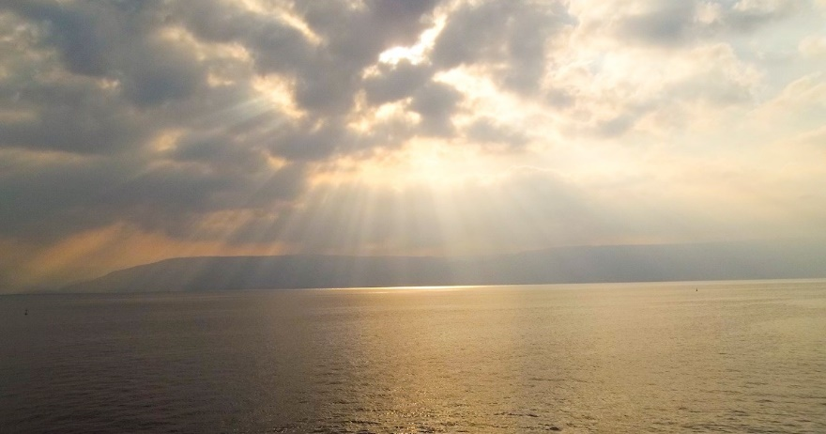
Worship is something
that everyone does, but
many don’t realize it.

Slide 4

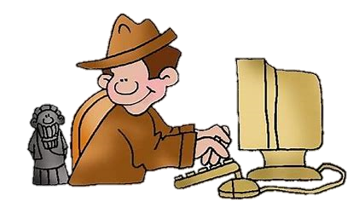
Archeologists have never unearthed a civilization that didn’t worship something.

Slide 5

Acts 17: 22
So Paul stood in the midst of the Areopagus and said, " Men of Athens, I observe that you are very religious in all respects. 23 Forwhile I was passing through and examining the objects of your worship, I also found an altar with this inscription, 'TO AN UNKNOWN GOD.' Therefore what you worship in ignorance, this I proclaim to you.

Slide 6

Fredric Robertson wrote :
It is not a thing which man can decide .. whether he will be a worshipper or not, but a worshipper he will be. The only question is what he will worship.

Slide 7
Fredric Robertson wrote :
It is not a thing which man can decide .. whether he will be a worshipper or not, but a worshipper he will be. The only question is what he will worship.

Slide 8
We were created to worship. Worship is the normal employment of moral beings. It is normal, not something stuck on or added like listening to a concert or admiring flowers. It is something built into human nature.
A.W. Tozer

Slide 9

I. The dictionary definitions
of worship are :

Slide 10
Defined by Merriam-Webster : ( verb )
1. to honor or show reverence
for as a divine being or
supernatural power
2. to regard with great or extravagant
respect, honor, or devotion

Slide 11
Kneel : Gonu : Fall on one’s knees, to bow, prostrate self before, humble.

Slide 12
Philippians 2:10 – so that at the name of Jesus every knee will bow, of those who are in Heaven and on earth and under the earth,
Ephesians 3: 14 – For this reason I bow my knees before the Father, from whom every ...
The one who worships, must acknowledge the superiority and the authority of the one being worshipped. How do you show it ?

Slide 13
Exodus 20:5
You shall not worship them or serve them; for I, the Lord your God,
John 4: 24
God is spirit, and those who worship Him must worship in spirit and truth.”

Slide 14
Worship : Proskunein :
Closest to English “to worship”,
bow down to
Originates from the word “to kiss.”

Slide 15
Serve : Latreuo : Serve ( acts done ) with no thought of reward.

Slide 16
Exodus 20:5 – You shall not worship or serve them for I the Lord your God am a jealous
Deuteronomy 10:12-13 – Now, Israel, what does the Lord your God require from you, but to fear the Lord your God, to walk in all His ways and love Him, and to serve the Lord your God with all your heart and with all your soul, 13 and to keep the Lord’s commandments and His statutes which I am commanding you today for your good?

Slide 17
Joshua 24: 14-15 .
... Now, therefore, fear the Lord and serve Him in sincerity and truth; and put away the gods which your fathers served beyond the River and in Egypt, and serve the Lord. 15 If it is disagreeable in your sight to serve the Lord, choose for yourselves today whom you will serve: whether the gods which your fathers served which were beyond the River, or the gods of the Amorites .. but as for me and my house, we will serve the Lord.

Slide 18
The prophetess Anna worshipped and served.
Luke 2: 37
She never left the temple, serving night and day with fastings and prayers”
The actions one takes BECAUSE of his surrendered ( loving and worshipful ) heart is his service to God. It is done to please and glorify God.

Slide 19
Matthew 15: 8
This people honors Me with their lips, But their heart is far away from Me.
Psalms 122: 1
I was glad when they said to me, “Let us ﻿﻿go to the house of the LORD.”

Slide 20
II. Worship is a theme which
flows from Genesis through
the end of the Revelation.

Slide 21
Exodus 23: 14
Three times a year you shall celebrate a feast to Me. 15 "You shall observe the Feast of Unleavened Bread; … And none shall appear before Me empty-handed. 16 "Also you shall observe the Feast of the Harvest of the first fruits of your labors from what you sow in the field; also the Feast of the Ingathering at the end of the year when you gather in the fruit of your labors from the field. 17 Three times a year all your males shall appear before the Lord God.

Slide 22
Psalms 122: 1
I was glad when they said to me,
"Let us go to the house of the Lord."
( Sorry, I can’t go; I gotta go to church. )

Slide 23
III. Not all worship is
acceptable to God.

Slide 24
Genesis 4: 4
Abel, on his part also brought of the firstlings of his flock and of their fat portions. And the Lord had regard for Abel and for his offering; 5 but for Cain and for his offering He had no regard. So Cain became very angry and his countenance fell.

Slide 25
Leviticus 10: 1
Now Nadab and Abihu, the sons of Aaron, took their respective firepans, and after putting fire in them, placed incense on it and offered strange fire before the Lord, which He had not commanded them. 2 And fire came out from the presence of the Lord and consumed them, and they died before the Lord.

Slide 26
Isaiah 1: 13 –
Bring your worthless offerings no longer, incense is an abomination to Me. New moon and sabbath, the calling of assemblies — I cannot endure iniquity and the solemn assembly. 14 I hate your new moon festivals and your appointed feasts, They have become a burden to Me; I am weary of bearing them.

Slide 27
Malachi 1: 7
You are presenting defiled food upon My altar. But you say, 'How have we defiled You?' In that you say, 'The table of the Lord is to be despised.' 8 But when you present the blind for sacrifice, is it not evil? And when you present the lame and sick, is it not evil? …
A.W. Tozer commented: Worship is the missing jewel in modern Christianity

Slide 28
Matthew 15: 7
You hypocrites, rightly did Isaiah prophesy of you: 8 'This people honors Me with their lips, but their heart is far away from Me. 9 'but in vain do they worship Me, teaching as doctrines the precepts of men.'

Slide 29
IV. Worship is a forgotten
virtue in today’s society.

Slide 30
Worship is to unashamedly acknowledge God for what He is.

Slide 31
John 20: 28
Thomas answered and said to Him, "My Lord and my God!"
Revelation 1: 17
When I saw Him, I fell at His feet like a dead man. And He placed His right hand on me, saying, "Do not be afraid; I am the first and the last, 18 and the living One; and I was dead, and behold, I am alive forevermore, and I have the keys of death and of Hades.

Slide 32
Satan seeks your worship :
Luke 4: 7
“Therefore if You worship before me ( Satan ), it shall all be Yours.“ 8 Jesus answered him, "It is written, 'You shall worship the Lord your God and serve Him only.'"

Slide 33

Worship is a heart to heart experience with God.

Slide 34
It is an experience
which I urge you
to enjoy every day.

