Slide 1

Studies
In
Christianity

Slide 2

The Christian Lifestyle #13
Christians Are Positive People

Slide 3

Characteristics of the Christian lifestyle
Our previous two lessons were about the contentment that is rooted in our being satisfied with what God has provided for us.

Slide 4
The Lord made a covenant with us. If we put him first in our lives, He will provide for our physical needs.
Matthew 6: 33 – But seek first His kingdom and His righteousness, and all these things will be added to you.
Psalms 89: 34 – My covenant I will not violate,
Nor will I alter the utterance of My lips.

Slide 5
I Corinthians 10: 13
No temptation has overtaken you but such as is common to man; and God is faithful, who will not allow you to be tempted beyond what you are able, but with the temptation will provide the way of escape also, so that you will be able to endure it.

Slide 6
Five Practical Reasons To Stay Positive
1. Staying positive reduces stress.
2. Social interaction
3. Love
4. Performance at Work
5. Life Expectancy

Slide 7
How do we stay positive amid negativity?
Winston Churchill lived at such a time as this and stayed positive among negative peers.
He said,
A positive thinker sees the invisible, feels the intangible, and achieves the impossible

Slide 8

I. Vs. 2-3 .. Don’t fill
your mind with the
pain of the past.

Slide 9
Philippians 4: 2-3
I urge Euodia and I urge Syntyche to live in harmony in the Lord. 3 Indeed, true companion, I ask you also to help these women who have shared my struggle in the cause of the gospel, together with Clement also and the rest of my fellow workers, whose names are in the book of life.

Slide 10
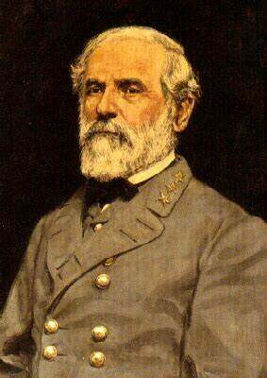
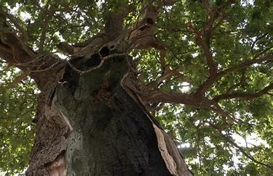
“Mam, cut it down and forget it.”

Slide 11
II. Vs. 4 .. Rejoice in
the Lord.

Slide 12
Philippians 3: 12
Not that I have already obtained it or have already become perfect, but I press on so that I may lay hold of that for which also I was laid hold of by Christ Jesus. 13 Brethren, I do not regard myself as having laid hold of it yet; but one thing I do: forgetting what lies behind and reaching forward to what lies ahead, 14 I press on toward the goal for the prize of the upward call of God in Christ Jesus.

Slide 13
Philippians 4: 4
Rejoice in the Lord always; again I will say, rejoice!

Slide 14
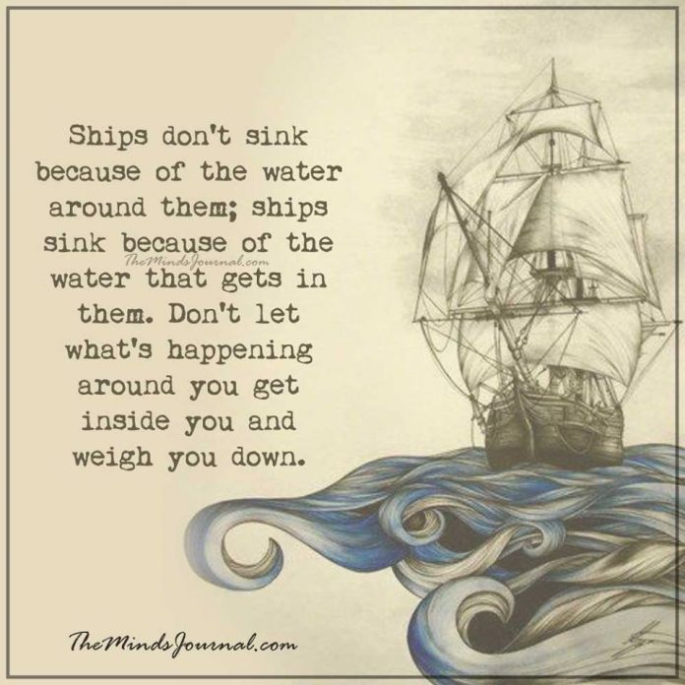

Slide 15
III. Vs. 5 .. Be gentle
with others.

Slide 16
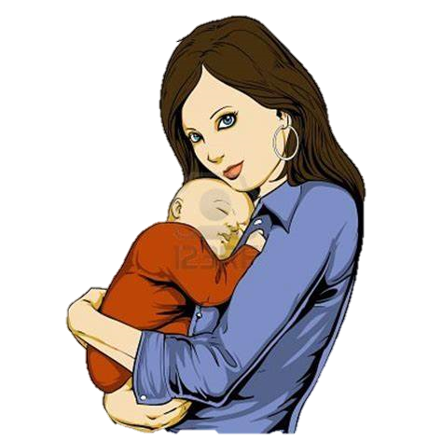
Philippians 4: 5
Let your gentle spirit be known to all men. The Lord is near.

Slide 17
Colossians 3: 12
So, as those who have been chosen of God, holy and beloved, put on a heart of compassion, kindness, humility, gentleness and patience; 13 bearing with one another, and forgiving each other,

Slide 18
I Timothy 3: 3
temperate, prudent, respectable, hospitable, able to teach, 3 not addicted to wine or pugnacious, but gentle, peaceable,
Titus 3: 2
Remind them to be … 2 to malign no one, to be peaceable, gentle, showing every consideration for all men.

Slide 19
II. Vs. 6-7.. Replace your
anxiety with prayer.

Slide 20
Philippians 4: 6
Be anxious for nothing, but in everything by prayer and supplication with thanksgiving let your requests be made known to God. 7 And the peace of God, which surpasses all comprehension, will guard your hearts and your minds in Christ Jesus.

Slide 21
V. Vs. 8 .. Look for what
is good.

Slide 22

Philippians 4: 8
Finally, brethren, whatever is true, whatever is honorable, whatever is right, whatever is pure, whatever is lovely, whatever is of good repute, if there is any excellence and if anything worthy of praise, dwell on these things.

Slide 23


Slide 24
VI. Vs. 9 .. Act on what
you know to be right.

Slide 25
Philippians 4: 9
The things you have learned and received and heard and seen in me, practice these things, and the God of peace will be with you.

Slide 26
View yourself as the Apostle Paul viewed himself.
1. As a sinner ( Rom. 7 )
2. As a roll model
I Corinthians 11: 1
Be imitators of me,
just as I also am of Christ.

Slide 27
So, how does one stay positive ?
1. Doesn’t fill his mind with pain from the past
2. Rejoices in the Lord.
3. Is gentle to others.
4. Replaces his anxieties with prayer.
5. Looks for what is good.
6. Acts on what he knows to be right.

Slide 28
No one has more reason to be positive than a Christian.
1. We have a personal relationship with God.
2. When this life is over we will live with God.
3. God will work all the negatives to our good.

Slide 29
-Are you walking with God ?
-Do you have grounds for a positive outlook on eternity?
-> God is inviting you now !

Slide 33
Philippians
1: 3 I thank my God in all my remembrance of you, 4 always offering prayer with joy in my every prayer for you all, 5 in view of your participation in the gospel from the first day until now. 6 For I am confident of this very thing, that He who began a good work in you will perfect it until the day of Christ Jesus.
2: 3 Do nothing from selfishness or empty conceit, but with humility of mind regard one another as more important than yourselves; 4 do not merely look out for your own personal interests, but also for the interests of others. 5
continued …

Slide 34
Philippians continuation …
5 Have this attitude in yourselves which was also in Christ Jesus, 6 who, although He existed in the form of God, did not regard equality with God a thing to be grasped, 7 but emptied Himself,
3: 1 Finally, my brethren, rejoice in the Lord. To write the same things again is no trouble to me, and it is a safeguard for you.
2 Beware of the dogs, beware of the evil workers, beware of the false circumcision; 3 for we are the true circumcision,
continued …
anxious for nothing, but in everything by prayer and supplication with thanksgiving let your requests be made known to God. 7 And the peace of God, which surpasses all comprehension, will guard your hearts and your minds in Christ Jesus.
8 Finally, brethren, whatever is true, whatever is honorable, whatever is right, whatever is pure, whatever is lovely, whatever is of good repute, if there is any excellence and if anything worthy of praise, dwell on these things. 9 The things you have learned and received and heard and seen in me, practice these things, and the God of peace will be with you.

Slide 35
Philippians continuation …
who worship in the Spirit of God and glory in Christ Jesus and put no confidence in the flesh,
4: 2 I urge Euodia and I urge Syntyche to live in harmony in the Lord. 3 Indeed, true companion, I ask you also to help these women who have shared my struggle in the cause of the gospel, together with Clement also and the rest of my fellow workers, whose names are in the book of life.
Rejoice in the Lord always; again I will say, rejoice! 5 Let your gentle spirit be known to all men. The Lord is near. 6 Be
continued …
anxious for nothing, but in everything by prayer and supplication with thanksgiving let your requests be made known to God. 7 And the peace of God, which surpasses all comprehension, will guard your hearts and your minds in Christ Jesus.
8 Finally, brethren, whatever is true, whatever is honorable, whatever is right, whatever is pure, whatever is lovely, whatever is of good repute, if there is any excellence and if anything worthy of praise, dwell on these things. 9 The things you have learned and received and heard and seen in me, practice these things, and the God of peace will be with you.

Slide 36
Philippians continuation …
anxious for nothing, but in everything by prayer and supplication with thanksgiving let your requests be made known to God. 7 And the peace of God, which surpasses all comprehension, will guard your hearts and your minds in Christ Jesus.
8 Finally, brethren, whatever is true, whatever is honorable, whatever is right, whatever is pure, whatever is lovely, whatever is of good repute, if there is any excellence and if anything worthy of praise, dwell on these things. 9 The things you have learned and received and heard and seen in me, practice these things, and the God of peace will be with you.

