Slide 1

Confronting Evil

Slide 2

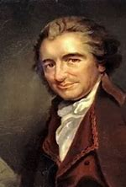
These are the times
that try men’s souls

Slide 3

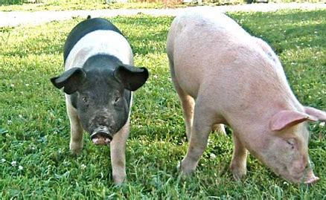
Animal Instincts

Slide 4

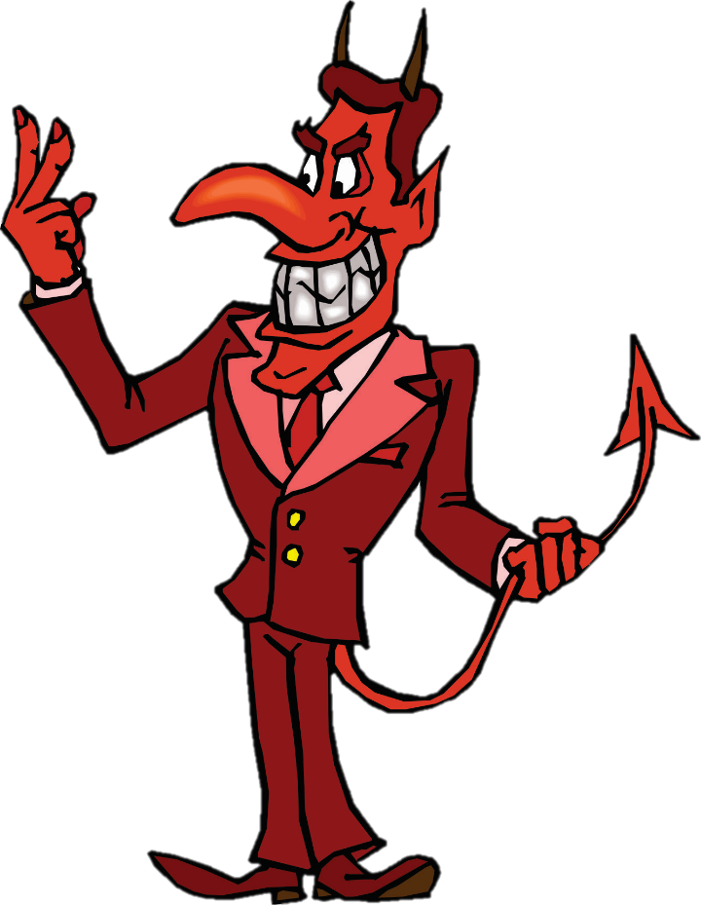
The devil’s favorite verse.
Matthew 7:1
Do not judge so that you
will not be judged.
A verse out of context is but a pretext.

Slide 5

This lesson will explore confronting evil
1. We do not have the option to ignore evil.
2. In a dark world even a small light is bright.
3. Our life of peace becomes ever more obvious.
4. Greater opportunities manifest themselves.
5. Christian clings ever more tightly to the Christ.

Slide 6

I. Christians do not have the
option to retreat into a
secure bubble.

Slide 7
We are obligated to warn …
Ezekiel 3: 18
When I say to the wicked, 'You will surely die,' and you do not warn him or speak out to warn the wicked from his wicked way that he may live, that wicked man shall die in his iniquity, but his blood I will require at your hand.

Slide 8
No one else will warn sinners.
Romans 6: 23
For the wages of sin is death,
Hebrews 11:25
Moses, when he had grown up, refused to be called the son of Pharaoh's daughter, 25 choosing rather to endure ill-treatment with the people of God than to enjoy the passing pleasures of sin,
“Come, sin will make you happy.”

Slide 9
God sent His servants out with a message
Mark 16:15
And He ( Jesus ) said to them, “Go into all the world and preach the gospel to all creation. 16 “He who has believed and has been baptized shall be saved; but he who has disbelieved shall be condemned.”

Slide 10
I Corinthians 15: 1
Now I make known to you, brethren, the gospel which I preached to you, which also you received, in which also you stand, 2 by which also you are saved, if you hold fast the word which I preached to you, unless you believed in vain. 3 For I delivered to you as of first importance what I also received, that Christ died for our sins according to the Scriptures, 4 and that He was buried, and that He was raised on the third day according to the Scriptures,

Slide 11
Acts 17: 30
Therefore having overlooked the times of ignorance, God is now declaring to men that all people everywhere should repent,
Luke 24: 46
He ( Jesus ) said to them, “Thus it is written, that the Christ would suffer and rise again from the dead the third day, 47 and that repentance for forgiveness of sins would be proclaimed in His name to all the nations, beginning from Jerusalem.”

Slide 12
Silence is an act of violence.
Obadiah 1: 10
Because of violence to your brother Jacob, You will be covered with shame, And you will be cut off forever. 11 On the day that you stood aloof, On the day that strangers carried off his wealth, And foreigners entered his gate And cast lots for Jerusalem — You too were as one of them.

Slide 13
Ezekiel 3: 18
When I say to the wicked, 'You will surely die,' and you do not warn him or speak out to warn the wicked from his wicked way that he may live, that wicked man shall die in his iniquity, but his blood I will require at your hand. 19 Yet if you have warned the wicked and he does not turn from his wickedness or from his wicked way, he shall die in his iniquity; but you have delivered yourself.

Slide 14
II. In a dark world even a
small light provides
significant illumination.

Slide 15
Jesus set you / us up as a light.
Matthew 5: 16
Let your light shine before men in such a way that they may see your good works, and glorify your Father who is in heaven.
The darker the night the
more distant lights are visible.

Slide 16
Now is the time to be more bold.
I Corinthians 11: 1
Be imitators of me, just as I also am of Christ.
Romans 1: 16
For I am not ashamed of the gospel, for it is the power of God for salvation to everyone who believes, …..

Slide 17
III. As the world grows ever
darker our peace filled lives
become ever more obvious.

Slide 18
Stay cool under pressure – do not fear
I Peter 3: 14
But even if you should suffer for the sake of righteousness, you are blessed. And do not fear their intimidation, and do not be troubled, 15 but sanctify Christ as Lord in your hearts, always being ready to make a defense to everyone who asks you to give an account for the hope that is in you, yet with gentleness and reverence;

Slide 19
Matthew 10: 28
Do not fear those who kill the body but are unable to kill the soul; but rather fear Him who is able to destroy both soul and body in hell.
Romans 8: 31
What then shall we say to these things? If God is for us, who is against us? ……… 35 Who will separate us from the love of Christ? Will tribulation, or distress, or persecution, or famine, or nakedness, or peril, or sword?

Slide 20
We have the peace of being protected
Philippians 4: 7
And the peace of God, which surpasses all comprehension, will guard your hearts and your minds in Christ Jesus.
* You’ll never truly know that Christ is all you need until Christ is all you have.

Slide 21
IV. The darker the world gets
the greater opportunities
manifest themselves.

Slide 22
Acts 2: 41 – So then, those who had received his word were baptized; and that day there were added about three thousand souls. 42 They were continually devoting themselves to the apostles' teaching and to fellowship, to the breaking of bread and to prayer.
Acts 2: 47 – … with gladness and sincerity of heart, 47 praising God and having favor with all the people. And the Lord was adding to their number day by day those who were being saved.

Slide 23




The is have a that
Colossians 4: 5
Conduct yourselves with wisdom toward outsiders, making the most of the opportunity. 6 Let your speech always be with grace, as though seasoned with salt, so that you will know how you should respond to each person.

Slide 24
V. As the darkness closes in
the Christians clings ever
more tightly to Christ.

Slide 25
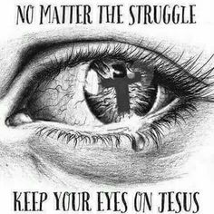
Where are your eyes focused ?

Slide 26
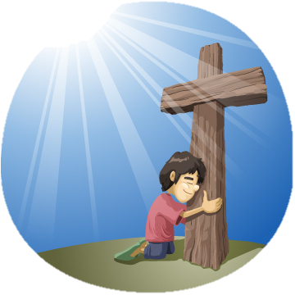
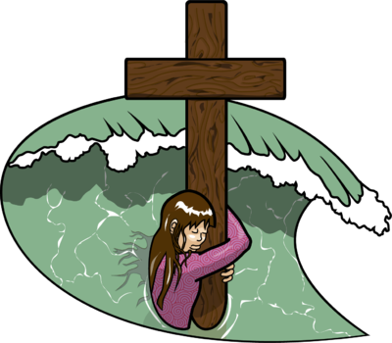
Are you clinging to His cross ?

Slide 27

Need help ? Are you fearful ?
Put in a call to God !

Slide 28
Yes,
These are the times
that try men’s souls,
so trust in God.

Slide 29
God has offered us some guidance for confronting evil
1. Do not ignore evil; confront sin in all forms.
2. In a dark world even your small light is bright.
3. Our peace filled life becomes ever more obvious.
4. Greater opportunities are manifesting themselves.
5. Christian clings ever more tightly to the Christ.

Slide 30
Do you have God’s peace
to guide you through
these troubled times ?

Slide 31


