Slide 1

Putting Aside
Judging

Slide 2

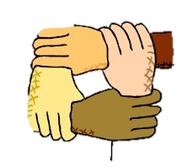
Last week we discussed
racism and prejudice.

Slide 3

Fatherless Youths
Suicide: 63 %
Runaways: 90 %
Behavioral Disorders: 85 %
High School Dropouts: 71 %
Juvenile Detention Rates: 70 %
Substance Abuse: 75 %

Slide 4

Hebrews 12: 5
you have forgotten the exhortation which is addressed to you as sons, "My son, do not regard lightly the discipline of the Lord, nor faint when you are reproved by Him; 6 for those whom the Lord loves He disciplines, and He scourges every son whom He receives." 7 It is for discipline that you endure; God deals with you as with sons; for what son is there whom his father does not discipline? 8 But if you are without discipline, of which all have become partakers, then you are illegitimate children and not sons.

Slide 5
We have a responsibility to the fatherless.
Psalms 82:3
Vindicate the weak and fatherless; Do justice to the afflicted and destitute. 4 Rescue the weak and needy; Deliver them out of the hand of the wicked.

Slide 6
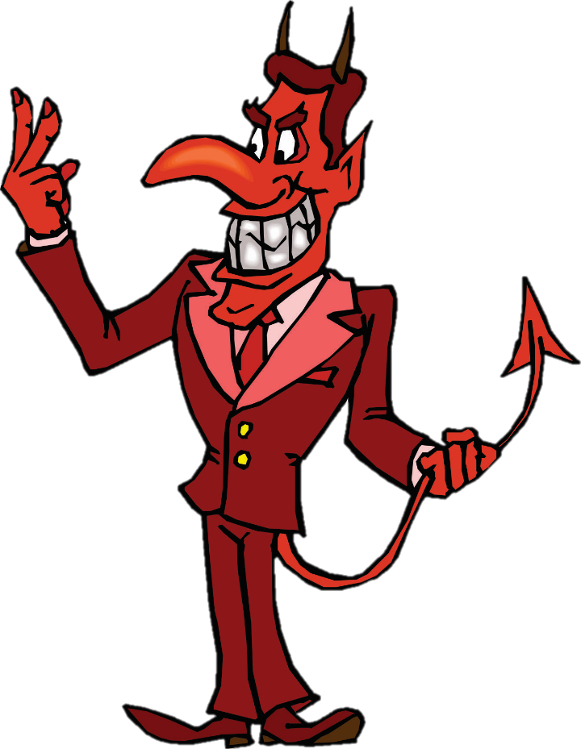
The devil’s favorite verse.
Matthew 7:1
Do not judge so that you
will not be judged.
A verse out of context is but a pretext.

Slide 7

I. Judging others requires
an ability which no one
possesses.

Slide 8
Matthew 5: 1
When Jesus saw the crowds, He went up on the mountain; and after He sat down, His disciples came to Him.
Mark 3: 22
The scribes who came down from Jerusalem were saying, "He is possessed by Beelzebul," and " He casts out the demons by the ruler of the demons."

Slide 9



Slide 10
Hebrews 4: 12
For the word of God is living and active and sharper than any two-edged sword, and piercing as far as the division of soul and spirit, of both joints and marrow, and able to judge the thoughts and intentions of the heart.

Slide 11
II. Not all judgment is forbidden,
in fact, some are required.

Slide 12
John 7: 24
Do not judge according to appearance, but judge with righteous judgment.
John 8: 15
You judge according to the flesh; I am not judging anyone. 16 "But even if I do judge, My judgment is true; for I am not alone in it, but I and the Father who sent Me.

Slide 13
James 2: 1
My brethren, do not hold your faith in our glorious Lord Jesus Christ with an attitude of personal favoritism. 2 For if a man comes into your assembly with a gold ring and dressed in fine clothes, and there also comes in a poor man in dirty clothes, 3 and you pay special attention to the one who is wearing the fine clothes, and say, "You sit here in a good place," and you say to the poor man, "You stand over there, or sit down by my footstool," 4 have you not made distinctions among yourselves, and become judges with evil motives?

Slide 14
III. Some judgment is essential
but other judgment is
forbidden.

Slide 15
Romans 14:1
Now accept the one who is weak in faith, but not for the purpose of passing judgment on his opinions. 2 One person has faith that he may eat all things, but he who is weak eats vegetables only. 3 The one who eats is not to regard with contempt the one who does not eat, and the one who does not eat is not to judge the one who eats, for God has accepted him. 4 Who are you to judge the servant of another? To his own master he stands or falls; and he will stand, for the Lord is able to make him stand.

Slide 16
Galatians 1: 8
But even if we, or an angel from heaven, should preach to you a gospel contrary to what we have preached to you, he is to be accursed!
II Peter 3: 16
As also in all his ( Paul’s ) letters, speaking in them of these things, in which are some things hard to understand, which the untaught and unstable distort, as they do also the rest of the Scriptures, to their own destruction.

Slide 17
When God has spoken we must agree,
But
God has not spoken about everything,
Ephesians 5:19
… speaking to one another in psalms and hymns and spiritual songs, singing and making melody with your heart to the Lord; 20 always giving thanks for all things in the name of our Lord Jesus Christ to God, even the Father

Slide 18
Some want to twist the command to say
“Sing the words and play the melody.”

Slide 19
VI. Properly evaluating things
which are observable and
provable is judging, but it
is not wrong.

Slide 20
I Corinthians 5: 1 – It is actually reported that there is immorality among you, and immorality of such a kind as does not exist even among the Gentiles, that someone has his father's wife. 2 You have become arrogant and have not mourned instead, so that the one who had done this deed would be removed from your midst. 3 For I, on my part, though absent in body but present in spirit, have already judged him who has so committed this, as though I were present. 4 In the name of our Lord Jesus, when you are assembled, and I with you in spirit, with the power of our Lord Jesus, 5 I have decided to deliver such a one to Satan for the destruction of his flesh, so that his spirit may be saved in the day of the Lord Jesus.

Slide 21
Matthew 18: 15
If your brother sins, go and show him his fault in private; if he listens to you, you have won your brother. 16 "But if he does not listen to you, take one or two more with you, so that by the mouth of two or three witnesses every fact may be confirmed. 17 "If he refuses to listen to them, tell it to the church; and if he refuses to listen even to the church, let him be to you as a Gentile and a tax collector.

Slide 22
This type of judgment is only
for those in the church.
I Corinthians 5: 12
For what have I to do with judging outsiders? Do you not judge those who are within the church?

Slide 23
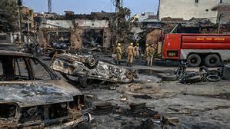

Slide 24
Those outside of Christ
have no hope of Heaven.
Ephesians 2:12
… having no hope and without God in the world.
John 14: 6
Jesus said to him, "I am the way, and the truth, and the life; no one comes to the Father but through Me.

Slide 25


