Slide 1

Studies
In
Christianity

Slide 2

The Christian Lifestyle #11
Compulsively Encouraging

Slide 3


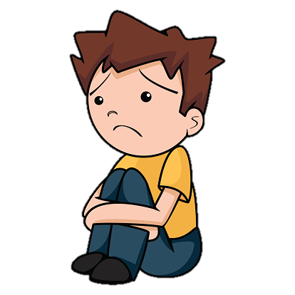
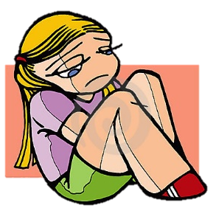
I’m lower’n a
whale’s belly.

Slide 4


Emotionally
Out of Gas

Slide 5
This lesson will consider :
1. Encouragement is scripturally mandated.
2. Encouragement flows from the heart.
3. Encouragement is a learned behavior.

Slide 6

I. Encouragement is
scripturally mandated.

Slide 7
I Thessalonians 5: 11
Therefore encourage one another and build up one another, just as you also are doing.
I Thessalonians 5: 14
We urge you, brethren, admonish the unruly, encourage the fainthearted, help the weak, be patient with everyone.

Slide 8
I Corinthians 14: 26
What is the outcome then, brethren? When you assemble, each one has a psalm, has a teaching, has a revelation, has a tongue, has an interpretation. Let all things be done for edification.
Romans 14: 19
So then we pursue the things which make for peace and the building up of one another.

Slide 9
Hebrews 10: 23
Let us hold fast the confession of our hope without wavering, for He who promised is faithful; 24 and let us consider how to stimulate one another to love and good deeds, 25 not forsaking our own assembling together, as is the habit of some, but encouraging one another; and all the more as you see the day drawing near.
Acts 15: 39 – there occurred such a sharp disagreement ( paroxusmos ) that they separated from one another,

Slide 10
At times each of us needs encouragement.
Hebrew 3: 12
Take care, brethren, that there not be in any one of you an evil, unbelieving heart that falls away from the living God. 13 But encourage one another day after day, as long as it is still called "Today," so that none of you will be hardened by the deceitfulness of sin.

Slide 11
The Apostles thought encouragement
was important enough to travel for it.
Colossians 4: 8
For I have sent him to you for this very purpose, that you may know about our circumstances and that he may encourage your hearts;

Slide 12
II. Encouragement flows
from a loving heart.

Slide 13
Love is the identifying
mark of a Christian.
John 13: 34
A new commandment I give to you, that you love one another, even as I have loved you, that you also love one another. 35 By this all men will know that you are My disciples, if you have love for one another.

Slide 14
Love is practiced in real actions.
I John 3: 18
A Little children, let us not love with word or with tongue, but in deed and truth.

Slide 15
Colossians 2: 1
For I want you to know how great a struggle I have on your behalf and for those who are at Laodicea, and for all those who have not personally seen my face, 2 that their hearts may be encouraged, having been knit together in love, and attaining to all the wealth that comes from the full assurance of understanding, resulting in a true knowledge of God's mystery, that is, Christ Himself, …

Slide 16
Galatians 6: 1
Brethren, even if anyone is caught in any trespass, you who are spiritual, restore such a one in a spirit of gentleness; each one looking to yourself, so that you too will not be tempted. 2 Bear one another's burdens, and thereby fulfill the law of Christ.

Slide 17
III. Encouragement is
a learned behavior.

Slide 18

Learned along the way
A priority to be taught
Need to discuss it more

Slide 19
Every Christian is responsible
to encourage the brethren.
Hebrews 3: 12
But encourage one another day after day, as long as it is still called "Today," so that none of you will be hardened by the deceitfulness of sin.

Slide 20
REMEMBER ..
Ezekiel 3: 18
When I say to the wicked, 'You will surely die,' and you do not warn him or speak out to warn the wicked from his wicked way that he may live, that wicked man shall die in his iniquity, but his blood I will require at your hand. 19 "Yet if you have warned the wicked and he does not turn from his wickedness or from his wicked way, he shall die in his iniquity; but you have delivered yourself.

Slide 21
Proverbs 3: 27
Do not withhold good from those to whom it is due, When it is in your power to do it.
Matthew 7: 12
In everything, therefore, treat people the same way you want them to treat you, for this is the Law and the Prophets.

Slide 22

We must develop an eye
for encouragement.

Slide 23
Romans 12: 15
Rejoice with those who rejoice, and weep with those who weep.
I Corinthians 12: 26
And if one member suffers, all the members suffer with it; if one member is honored, all the members rejoice with it.

Slide 24


Remember Jesus’ sacrifice

