Slide 1

Studies
In
Christianity

Slide 2

The Christian Lifestyle #9
A Forgiving Heart

Slide 3

Is this lesson is not
for new or causal
Christians.

Slide 4

Romans 12: 1-2
Therefore I urge you, brethren, by the mercies of God, to present your bodies a living and holy sacrifice, acceptable to God, which is your spiritual service of worship. 2 And do not be conformed to this world, but be transformed by the renewing of your mind, so that you may prove what the will of God is, that which is good and acceptable and perfect.

Slide 5
Colossians 3: 2
Set your mind on the things above, not on the things that are on earth. 3 For you have died and your life is hidden with Christ in God.
Romans 8: 6
For the mind set on the flesh is death, but the mind set on the Spirit is life and peace, 7 because the mind set on the flesh is hostile toward God; for it does not subject itself to the law of God, for it is not even able to do so, 8 and those who are in the flesh cannot please God.

Slide 6
The difference between Christians
and people of the world should be
like night and day.
Ephesians 5: 8
Therefore do not be partakers with them; 8 for you were formerly darkness, but now you are Light in the Lord; walk as children of Light

Slide 7
This summary of forgiveness :
1. Forgiving others is fundamental to Christianity.
2. Forgiveness Defined.
3. Forgiveness is not …
4. Developing a forgiving heart.

Slide 8
I. Forgiving others is
fundamental ot
Christianity.

Slide 9
Jose Ben Hanina, a famous rabbi from the 2nd century said, "He who begs forgiveness from his neighbor must not do so more than three times"
Rabbi Jose Ben Jehuda said, "If a man commits an offence once, they forgive him; if he commits an offence a second time, they forgive him; if he commits an offence a third time, they forgive him; the forth time they do not forgive."
Teaching based on Amos 1:3, 6, 9,11,13; 2:1, 4, 6

Slide 10
Amos 1: 3
Thus says the Lord, “For three transgressions of Damascus and for four I will not revoke its punishment, because they threshed Gilead with implements of sharp iron.”
The Jews defined a Sabbath day’s journey as 1500 steps.

Slide 11

Matthew 18: 21
Then Peter came and said to Him, "Lord, how often shall my brother sin against me and I forgive him? Up to seven times?" 22 Jesus said to him, "I do not say to you, up to seven times, but up to seventy times seven.

Slide 12
Ephesians 4: 32
Be kind to one another, tender-hearted, forgiving each other, just as God in Christ also has forgiven you.
Colossians 3: 12
So, as those who have been chosen of God, holy and beloved, put on a heart of compassion, kindness, humility, gentleness and patience; 13 bearing with one another, and forgiving each other, whoever has a complaint against anyone; just as the Lord forgave you, so also should you.

Slide 13
The Christian’s salvation depends on him forgiving others.
Matthew 6: 14
For if you forgive others for their transgressions, your heavenly Father will also forgive you. 15 But if you do not forgive others, then your Father will not forgive your transgressions.

Slide 14
II. Forgiveness Defined.

Slide 15
Webster defines forgiveness as :
1. : to stop feeling anger
2. : to stop requiring payment

Slide 16
Strong’s Enhanced Lexicon defines two words :
1. Matthew 18 , Mark 11
Forgive : aphiemi : 1 to send away. 1a to bid going away or depart. 1a1 of a husband divorcing his wife. 1b to send forth, yield up, to expire. 1c to let go, let alone, let be. 1c1 to disregard. 1c2 to leave, not to discuss now, (a topic).
2. Ephesian 4: 32 , Colossians 3:13
Forgive : charizomai : 1 to do something pleasant or agreeable (to one), to do a favour to, gratify. 1a to show one’s self gracious, kind, benevolent. 1b to grant forgiveness, to pardon. 1c to give graciously, give freely, bestow.

Slide 17
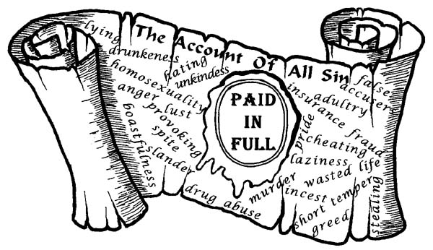
“certificate of debt”

Slide 18
III. Forgiveness is not …

Slide 19
It is not to approve of or accept the wrong committed.
“Go and sin no more.”

Slide 20
It is not to excuse the wrong.
“It really wasn’t a big deal.”

Slide 21
It is not to justify the offense.
“You didn’t mean it.”

Slide 22
It is not to pardoning the wrong.
The offender must deal with
sin, guilt, consequences, etc.

Slide 23
It is not reconciliation.
Forgiveness is not about restoring
warm and fussy feelings.

Slide 24
It is not to repress one’s feelings.
“I don’t want to talk about it.”

Slide 25
It is not forgetting the offense.
“I can forgive, but I can never forget.”

Slide 26
Jeremiah 31: 34
They will not teach again, each man his neighbor and each man his brother, saying, 'Know the Lord,' for they will all know Me, from the least of them to the greatest of them," declares the Lord, "for I will forgive their iniquity, and their sin I will remember no more.”

Slide 27
All words in the bible are not literal.
Isaiah 1: 18
Though your sins are as scarlet,
they will be as white as snow; ...
Isaiah 38: 17
For You have ﻿﻿cast all my sins behind Your back
Psalms 103: 12
Just as far as the east is from the west, so far has He removed our transgressions from us.

Slide 28
It is not pretending you were
not hurt by the offense.
“Sticks and stones may break my bones,
but words will never hurt me.” Not True

Slide 29
Forgiving is not optional.
“After what she did,
I never forgive her.”

Slide 30
Forging others is a clearly stated
and unambiguous command.
Colossians 3: 13
bearing with one another, and forgiving each other. whoever has a complaint against anyone; just as the Lord forgave you, so also should you.

Slide 31
Unforgiving people are lost.
Matthew 6: 15
But if you do not forgive others, then your Father will not forgive your transgressions.
Galatians 6: 7
... God is not mocked; for whatever a man sows, this he will also reap.

Slide 32
IV. Developing a
forgiving heart …

Slide 33
Forgiving others requires faith.
Luke 17: 3
Be on your guard! If your brother sins, rebuke him; and if he repents, forgive him. 4 "And if he sins against you seven times a day, and returns to you seven times, saying, 'I repent,' forgive him." 5 The apostles said to the Lord, "Increase our faith!"

Slide 34
Romans 12: 18
If possible, so far as it depends on you, be at peace with all men. 19 Never take your own revenge, beloved, but leave room for the wrath of God, for it is written, "Vengeance is mine, I will repay,“ says the Lord. 20 "But if your enemy is hungry, feed him, and if he is thirsty, give him a drink; for in so doing you will heap burning coals on his head." 21 Do not be overcome by evil, but overcome evil with good.

Slide 35
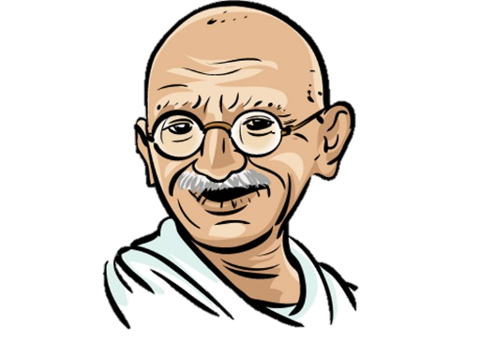
Though not a man of God Gandhi
was correct when he said,
“ The weak can never forgive;
forgiveness is the attribute
of the strong”

Slide 36
The famous theologian, C.S. Lewis very astutely said,
“Everyone thinks forgiveness is a lovely idea until they have something to forgive.”

Slide 37
Matthew 6: 14
For if you forgive others for their transgressions, your heavenly Father will also forgive you. 15 But if you do not forgive others, then your Father will not forgive your transgressions.

Slide 38
God is willing to keep forgiving ALL your sins, ( 70 x 7 )
“If you will surrender your
will to His and obey
His gospel.”

Slide 39
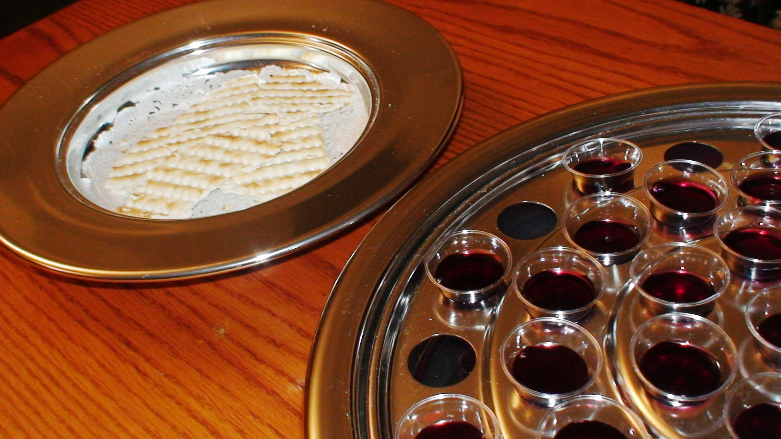
His Body was broken for us.
His Blood was shed for us.

