Slide 1


The Book of God
#2

Slide 2

Last week we began a study
of bibliology.
This is a study of God’s book.
The Greek word “Biblos” means book.

Slide 3
The bible is naturally divided into
the Old and New Covenants.
Chapters and verses are modern
additions for convenience of study.
ENARCHHNOLOGOCKAIOLOGOC
( THISISHOWENGLISHWOULDLOOK )

Slide 4
We have seen that God has communicated with man
in two ways.
General
Special

Slide 5
This lesson will address how God revealed Himself to man in the Holy Scriptures.

Slide 6

I. The scriptures affirm that
they are given to man
by God via inspiration.

Slide 7
God spoke to man through the prophets of old.

Slide 8

Daniel 9: 9-10
To the Lord our God belong compassion and forgiveness, for we have rebelled against Him; 10 nor have we obeyed the voice of the Lord our God, to walk in His teachings which He set before us through His servants the prophets.

Slide 9
Zechariah 1: 6
But did not My words and My statutes, which I commanded My servants the prophets, overtake your fathers? Then they repented and said, ' As the Lord of hosts purposed to do to us in accordance with our ways and our deeds.

Slide 10
Ezekiel 1: 2-3
(On the fifth of the month in the fifth year of King Jehoiachin's exile, 3 the word of the Lord came expressly to Ezekiel the priest, son of Buzi, in the land of the Chaldeans by the river Chebar; and there the hand of the Lord came upon him.)

Slide 11
The New Testament writers were also given their message by the Holy Spirit of God.

Slide 12
II Timothy 3: 15-16
and that from childhood you have known the sacred writings which are able to give you the wisdom that leads to salvation through faith which is in Christ Jesus. 16 All Scripture is inspired by God and profitable for teaching, for reproof, for correction, for training in righteousness;

Slide 13
II Peter 3: 15-16
and regard the patience of our Lord as salvation; just as also our beloved brother Paul, according to the wisdom given him, wrote to you, 16 as also in all his letters, speaking in them of these things, in which are some things hard to understand, which the untaught and unstable distort, as they do also the rest of the Scriptures, to their own destruction.

Slide 14
I Corinthians14: 37
If anyone thinks he is a prophet or spiritual, let him recognize that the things which I write to you are the Lord's commandment. 38 But if anyone does not recognize this, he is not recognized.

Slide 15
II. There are several theories
of inspiration, but no one
know exactly how it works.

Slide 16
The neo-orthodox view
of inspiration.
Fallible words by fallible men

Slide 17
The dictation theory
of inspiration.
Secretaries robotically transcribe

Slide 18
II Peter 1: 21
for no prophecy was ever made by an act of human will, but men moved by the Holy Spirit spoke from God.
Moved by = { pheró }:
to bear, carry a burden, bring forth
Acts 27: 16
when the ship was caught in it and could not face the wind, we gave way to it and let ourselves be driven { pheró }: along.

Slide 19
There were limited occasions in which men were instructed to write what God told them.
Jeremiah 30: 2
Thus says the Lord, the God of Israel, ' Write all the words which I have spoken to you in a book.

Slide 20
The limited inspiration theory.
Limited influence from God
primarily the work of men.
John 17: 17
Sanctify them in the truth; Your word is truth.
John 8: 32
… you will know the truth, and the truth will make you free.

Slide 21
III. The accurate view of
inspiration is that it
is verbal, plenary
and confluent.

Slide 22
Definition of terms :
Verbal : relating to or in the form of words.
Plenary : complete in every respect;
Confluent : flowing or running together;

Slide 23
The scriptures are verbally inspired.
II Timothy 3: 17
All Scripture is inspired by God and profitable for teaching, for reproof, for correction, for training in righteousness;
Psalms 33: 6
By the word of the Lord the heavens were made, And by the breath of His mouth all their host.

Slide 24
Galatians 3: 16
Now the promises were spoken to Abraham and to his seed. He does not say, "And to seeds," as referring to many, but rather to one, " And to your seed," that is, Christ.
Matthew 4: 4
But He answered and said, "It is written, 'Man shall not live on bread alone, but on every word that proceeds out of the mouth of God.'"

Slide 25
Mark 12: 25-27
"But regarding the fact that the dead rise again, have you not read in the book of Moses, in the passage about the burning bush, how God spoke to him, saying, 'I am the God of Abraham, and the God of Isaac, and the God of Jacob'? 27 "He is not the God of the dead, but of the living; you are greatly mistaken."

Slide 26
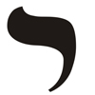

Matthew 5: 18
For assuredly, I say to you, till heaven and earth pass away, one jot or one tittle will by no means pass from the law till all is fulfilled.
( NKJV )
These were the smallest letters in the Hebrew alphabet.

Slide 27
The inspiration of the scriptures is plenary.
Every word is from God.

Slide 28
The inspiration of the scriptures is confluent.
God is the author and
men are the writers.

Slide 29
II Peter 1: 20-21
But know this first of all, that no prophecy of Scripture is a matter of one's own interpretation, 21 for no prophecy was ever made by an act of human will, but men moved by the Holy Spirit spoke from God.

Slide 30
I Peter 1: 10-12
As to this salvation, the prophets who prophesied of the grace that would come to you made careful searches and inquiries, 11 seeking to know what person or time the Spirit of Christ within them was indicating as He predicted the sufferings of Christ and the glories to follow. 12 It was revealed to them that they were not serving themselves, but you, in these things which now have been announced to you through those who preached the gospel to you by the Holy Spirit sent from heaven — things into which angels long to look.

Slide 31

For as often as you eat this bread and drink the cup, you proclaim the Lord's death until He comes.
I Corinthians 11: 26

Slide 32
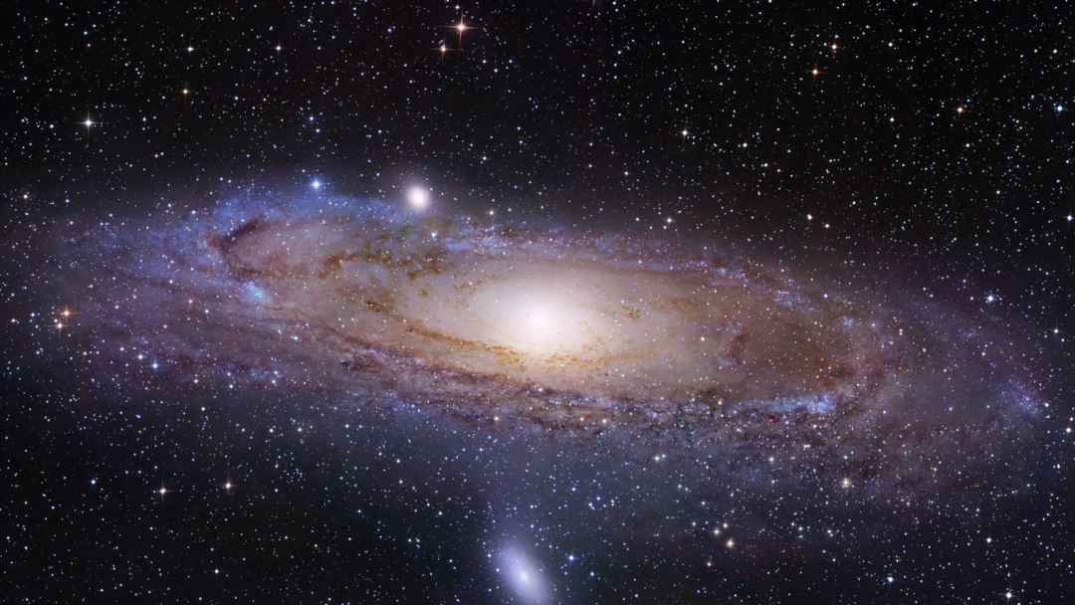
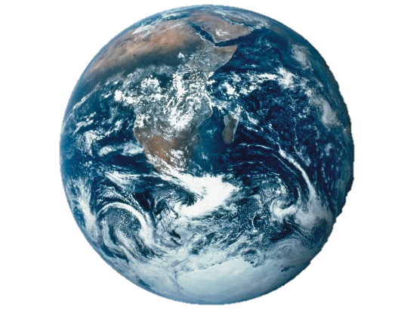
Correction :
200 Billion stars in the Milky Way
100 Billion galaxies in the universe
1,000,000,000,000,000,000,000,000 stars

